Slide 1
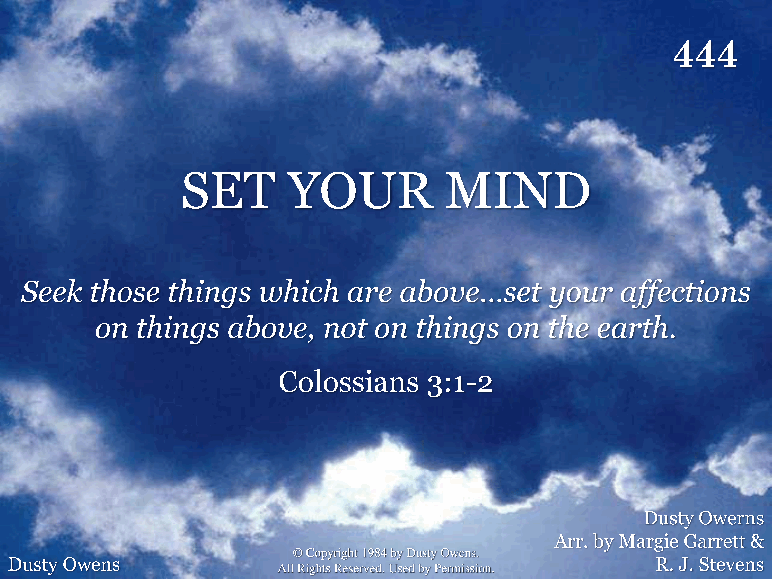
444 - Set Your Mind - Title

Slide 2
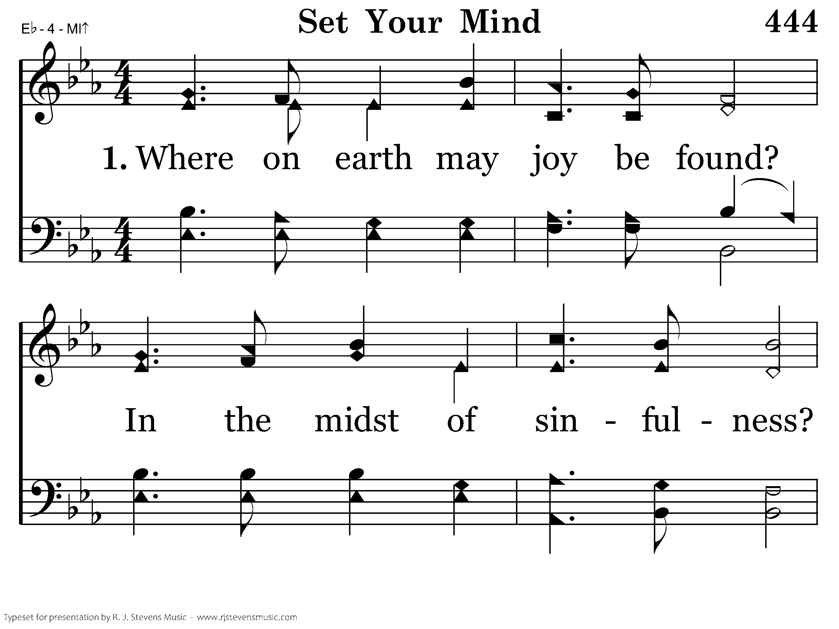
444 - Set Your Mind - 1.1

Slide 3
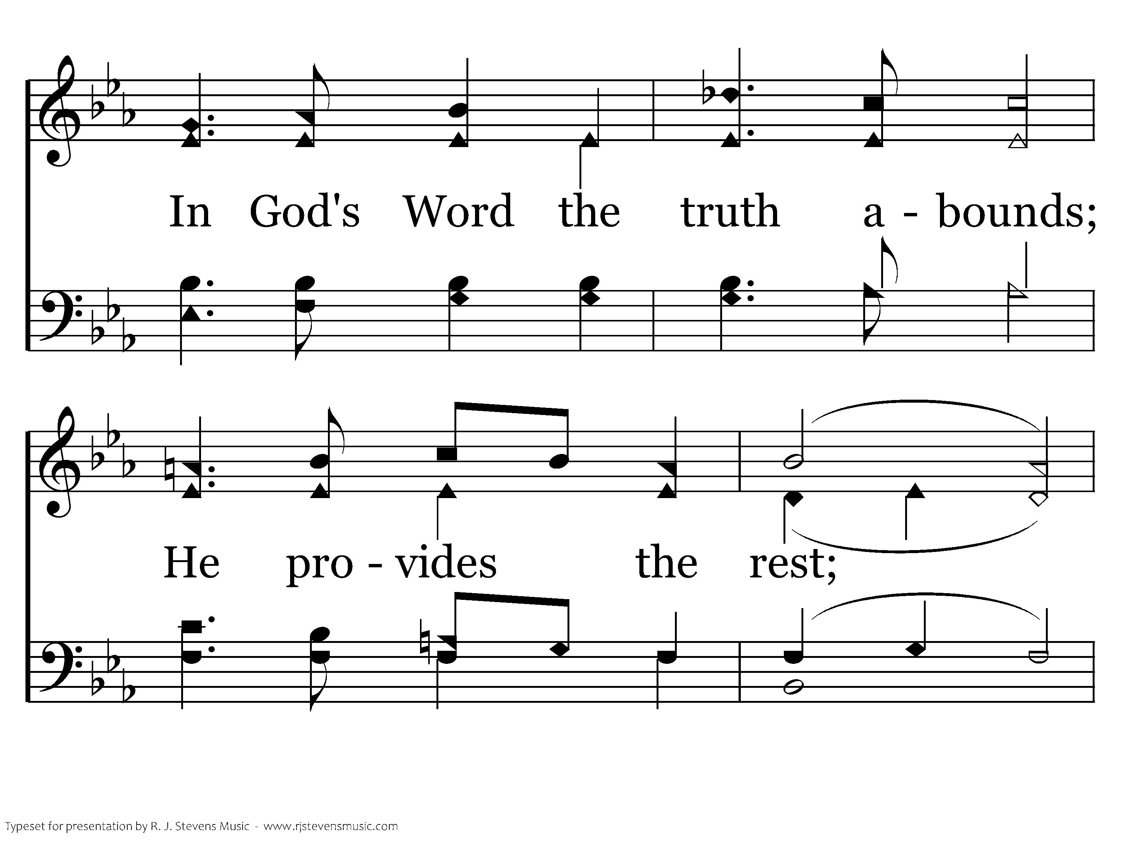
444 - Set Your Mind - 1.2

Slide 4
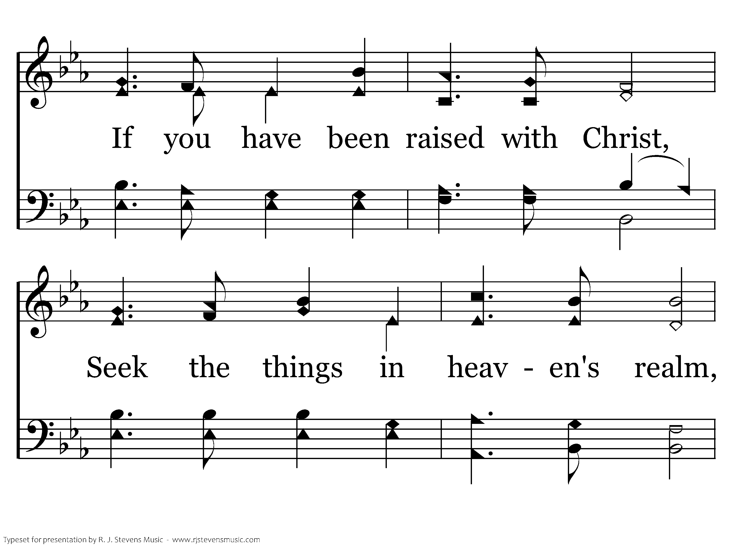
444 - Set Your Mind - 1.3

Slide 5
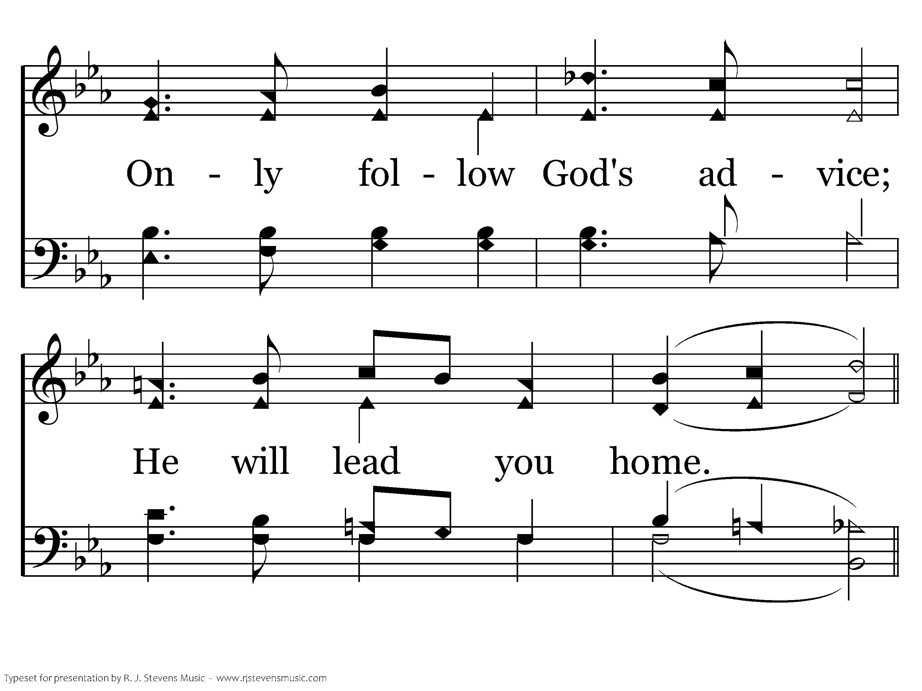
444 - Set Your Mind - 1.4

Slide 6
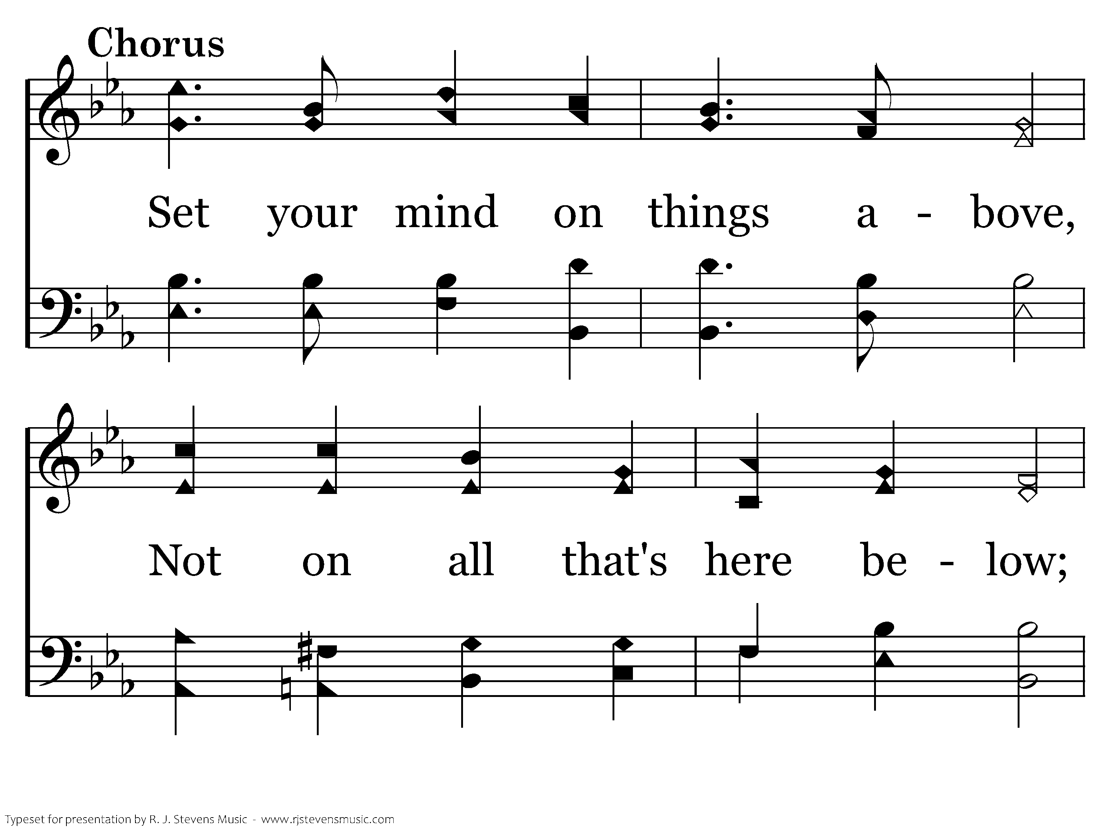
444 - Set Your Mind - C.1

Slide 7
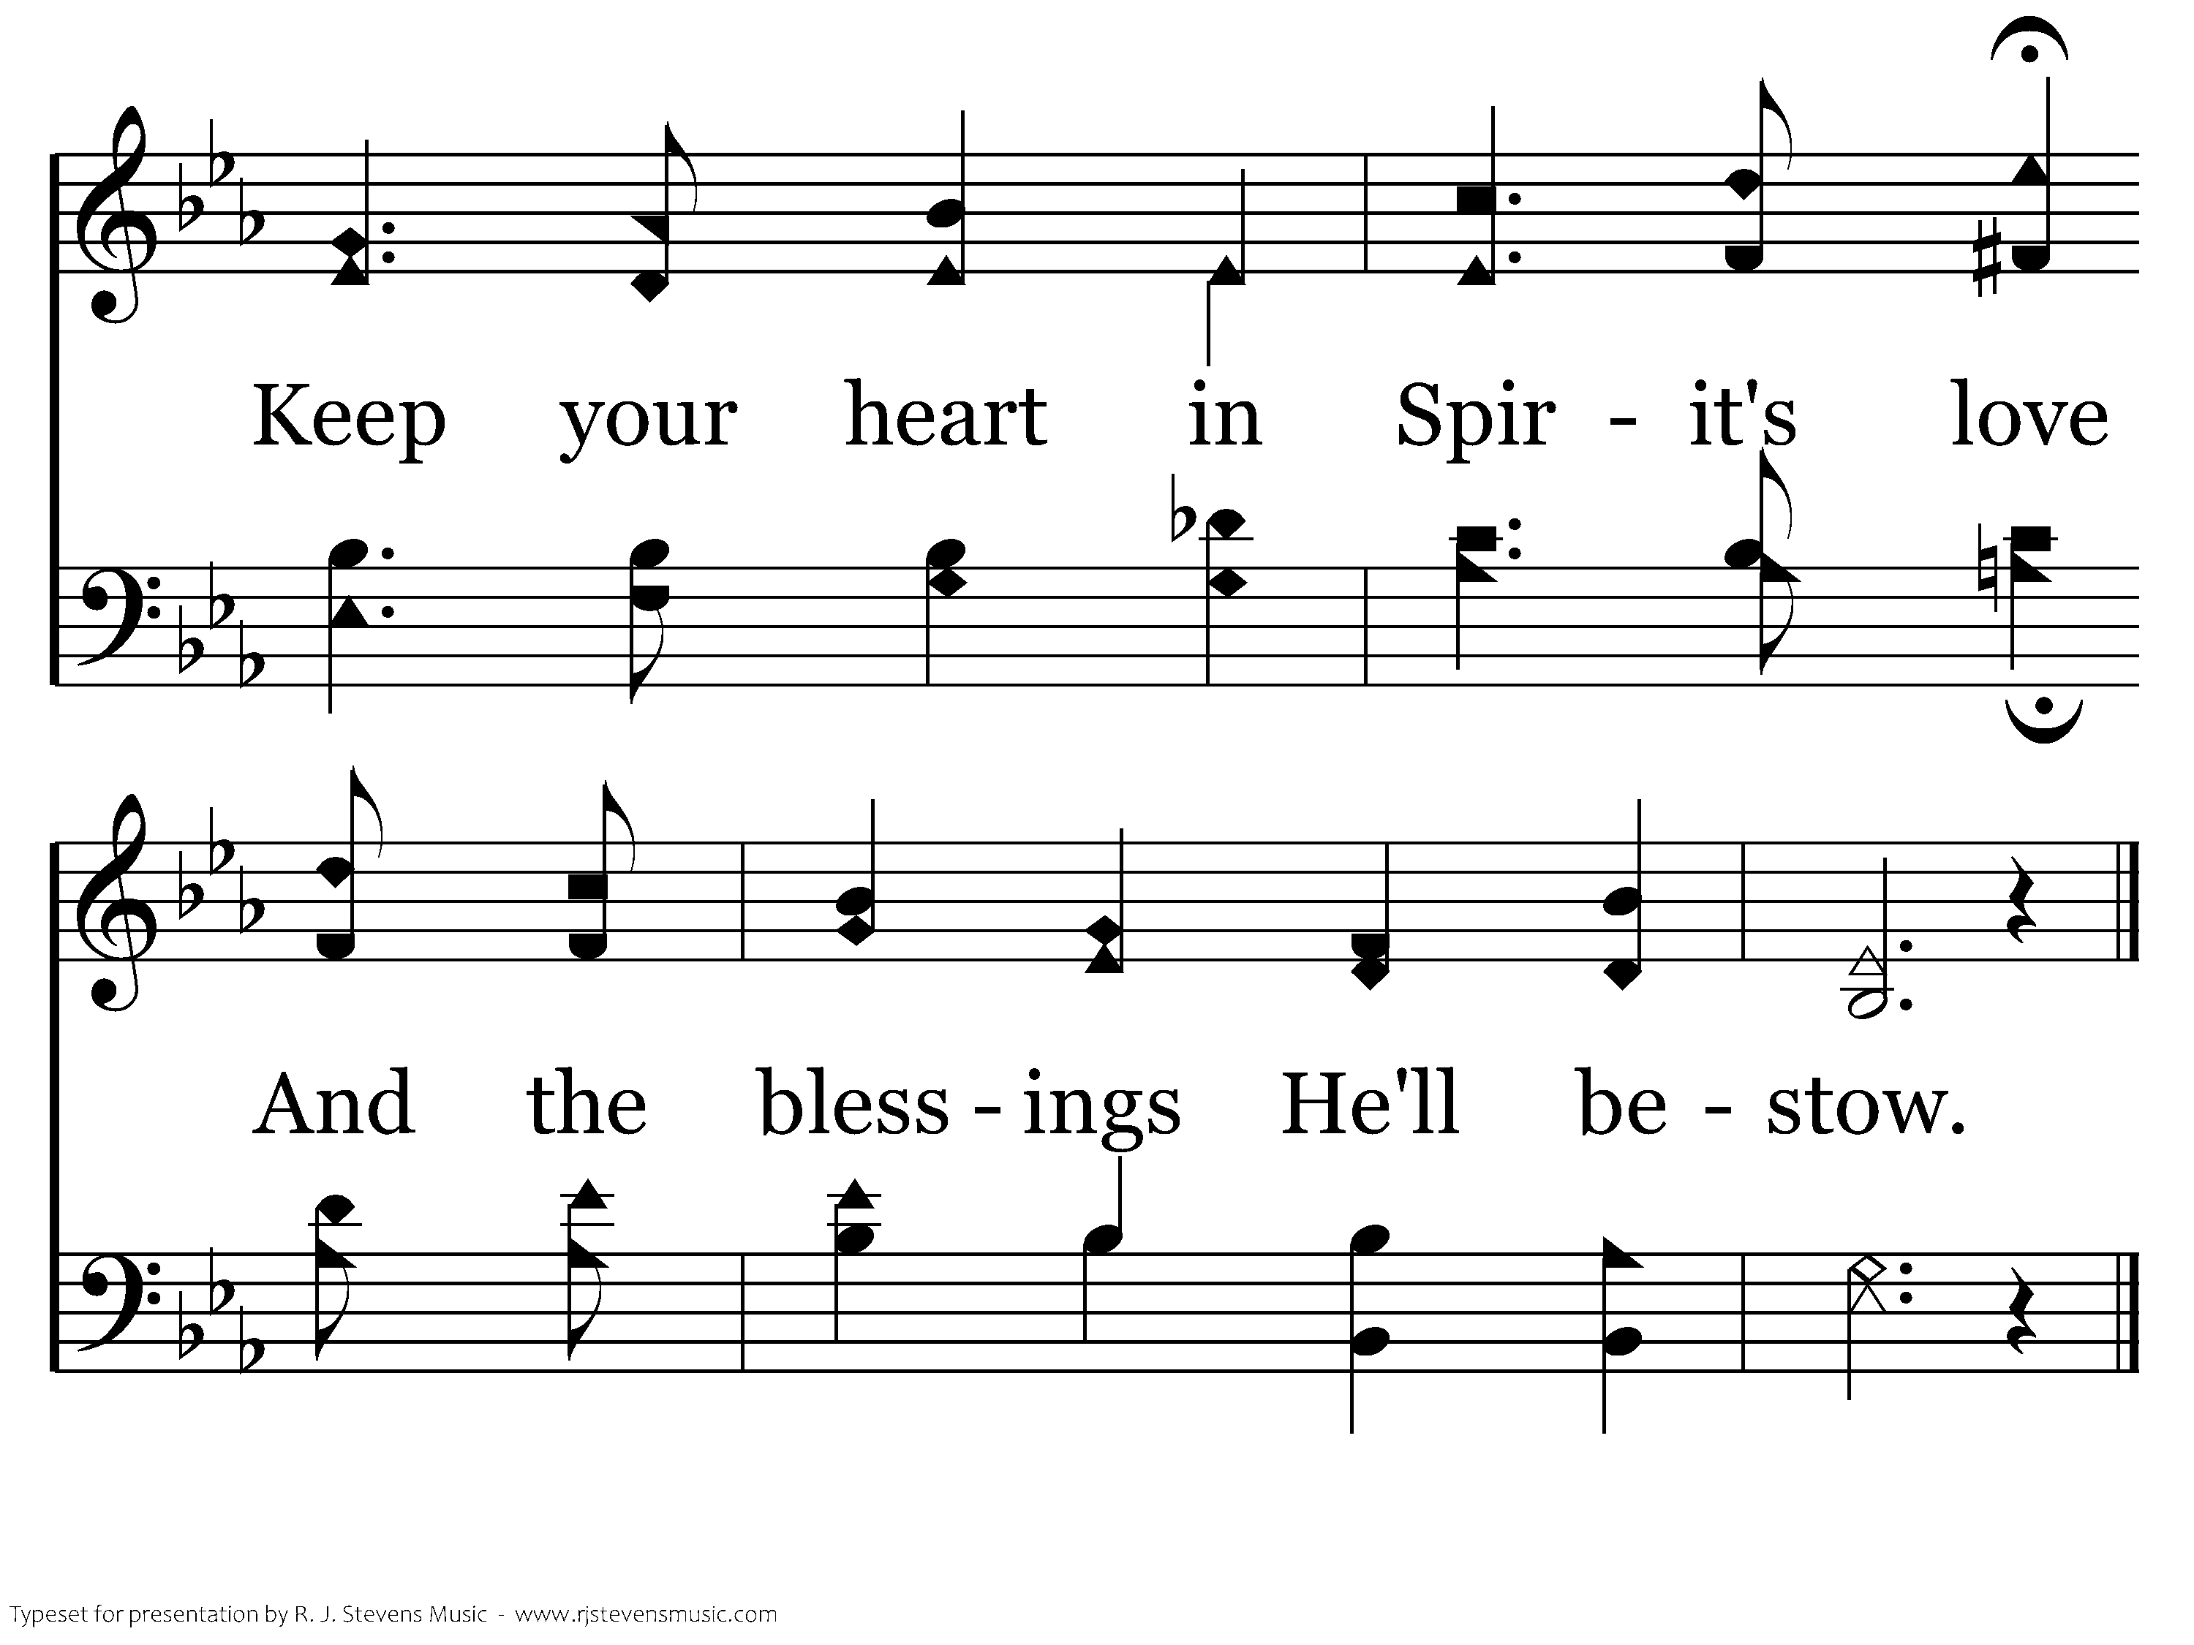
444 - Set Your Mind - C.2
End of Verse 1

Slide 8
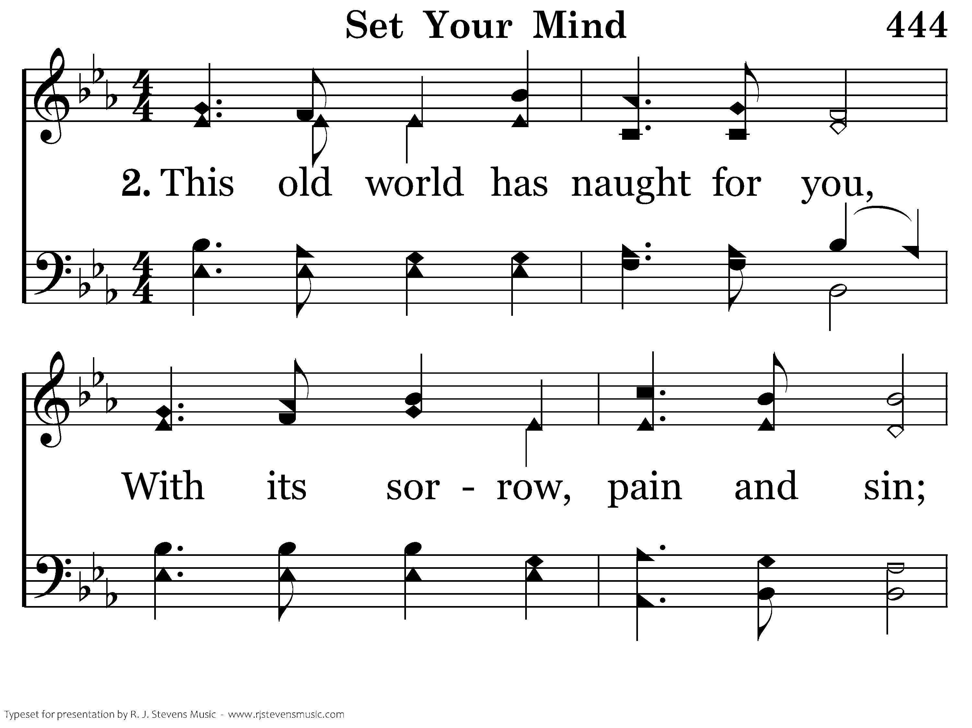
444 - Set Your Mind - 2.1

Slide 9
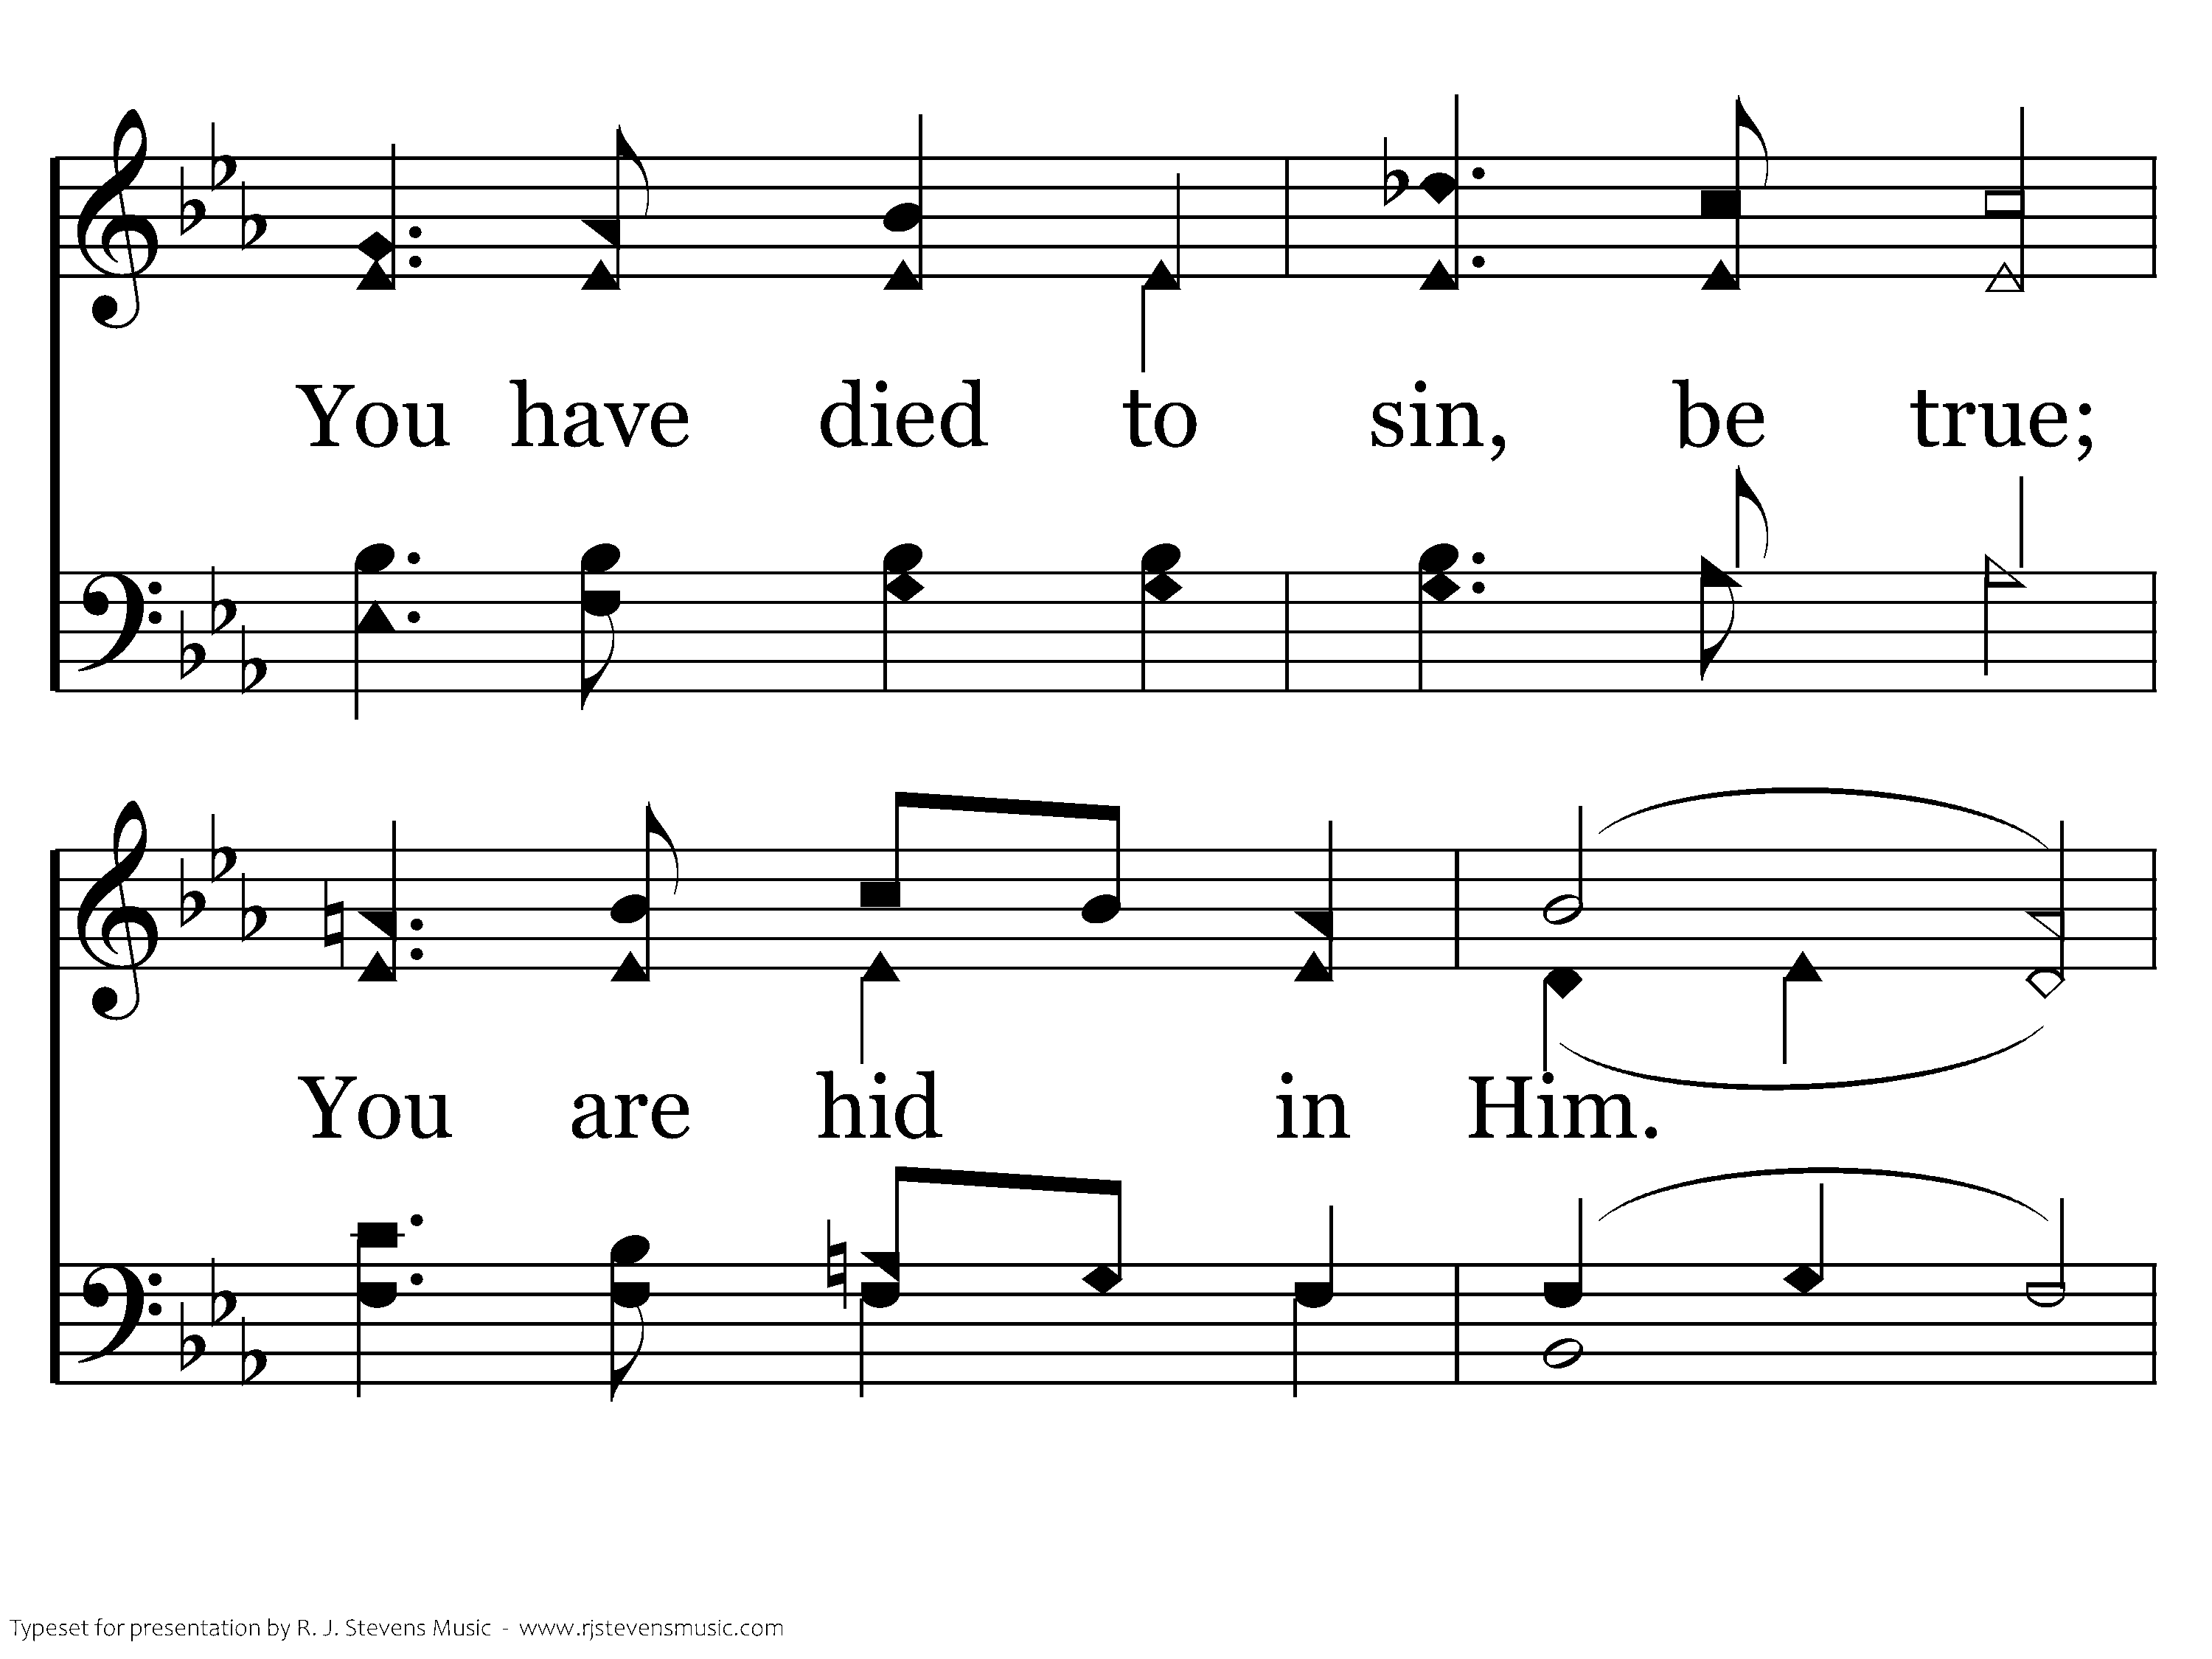
444 - Set Your Mind - 2.2

Slide 10
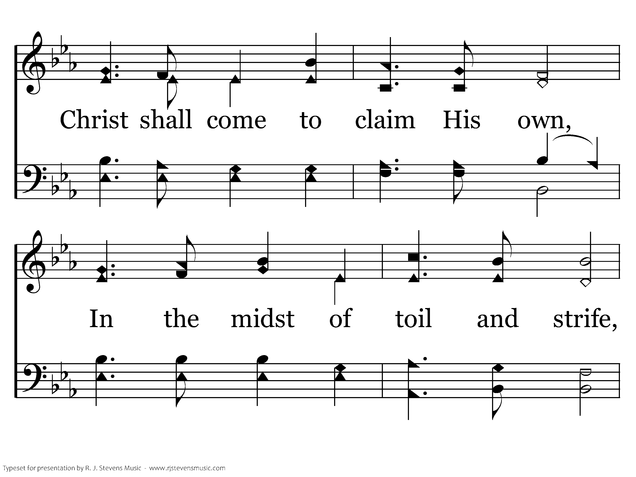
444 - Set Your Mind - 2.3

Slide 11
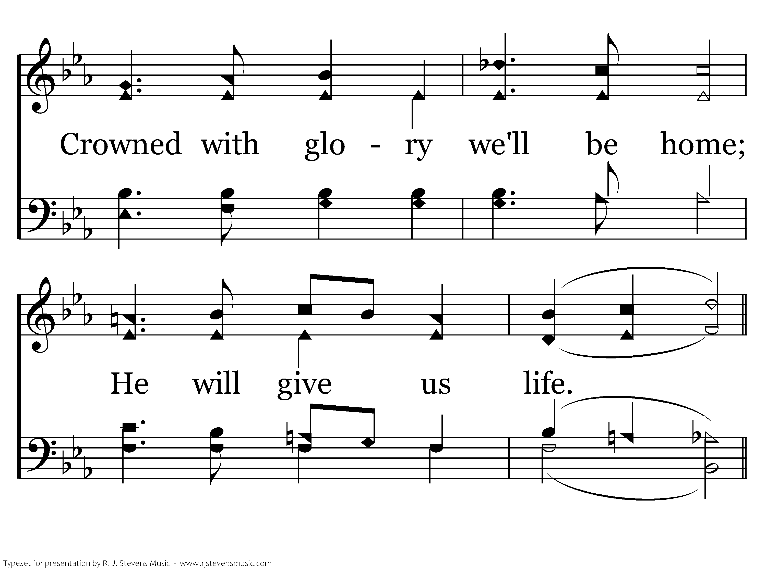
444 - Set Your Mind - 2.4

Slide 12
444 - Set Your Mind - C.1

Slide 13
444 - Set Your Mind - C.2
End of Song

Slide 14
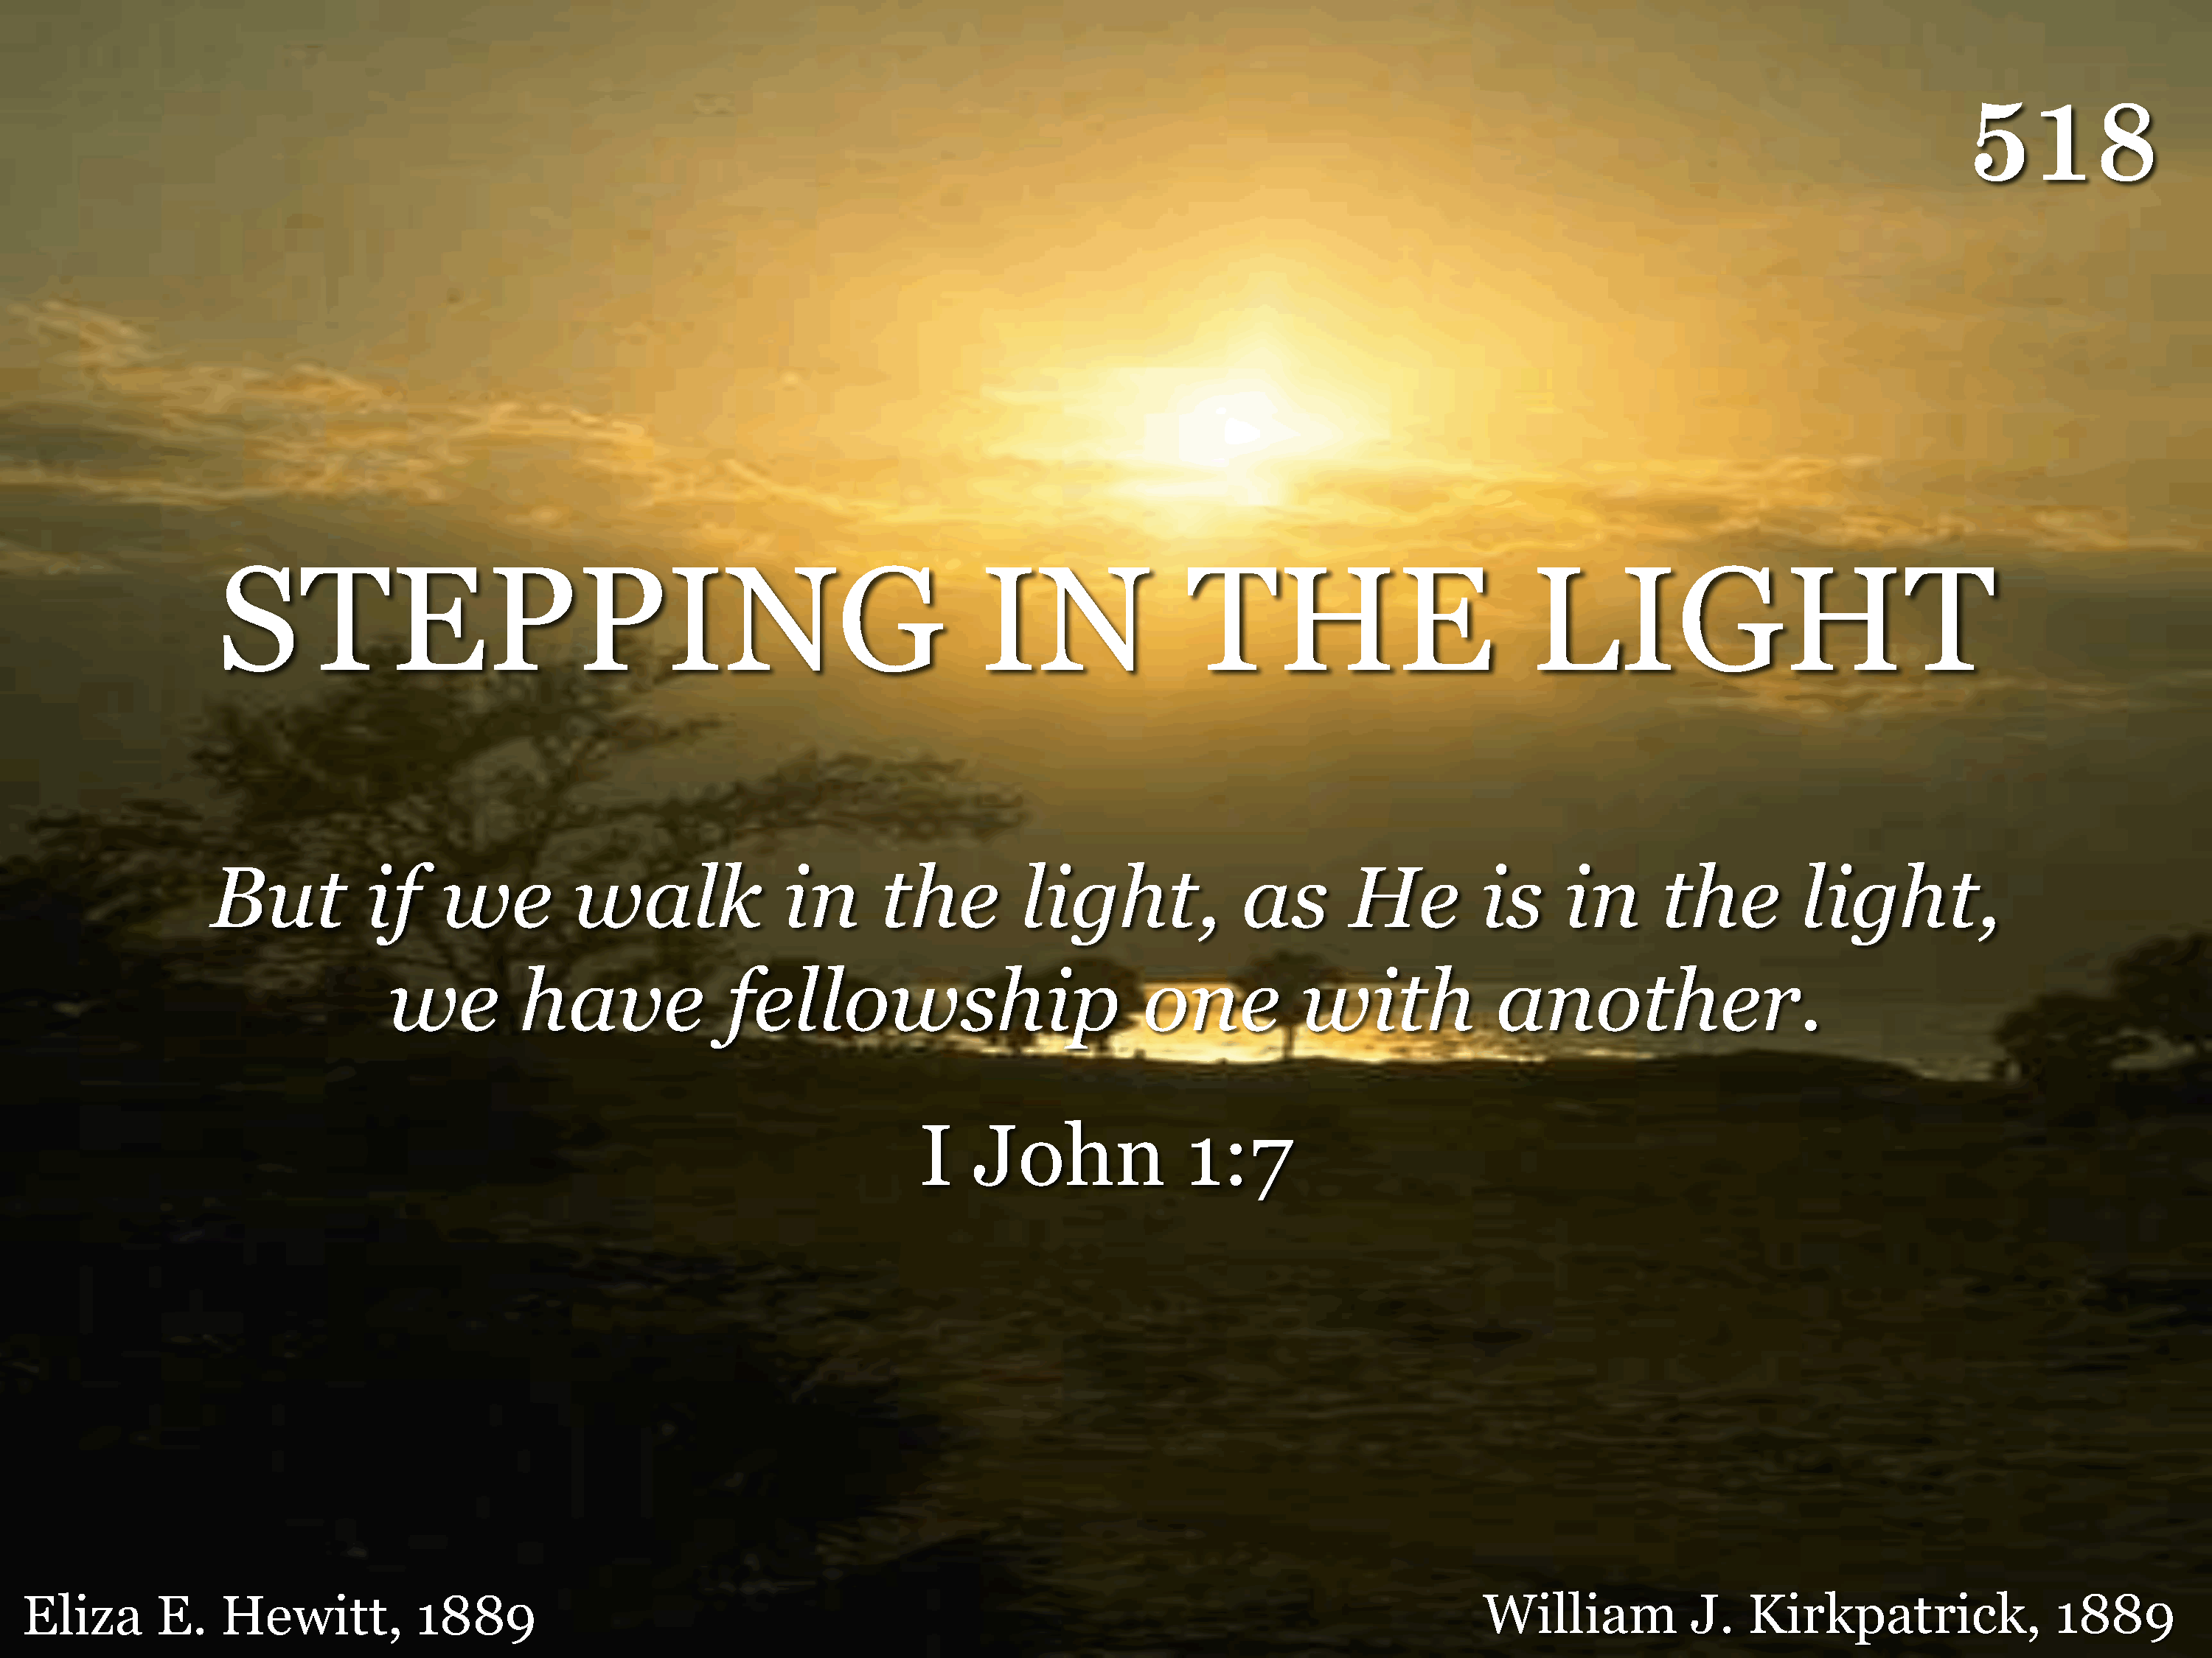
518 - Stepping In The Light - Title

Slide 15
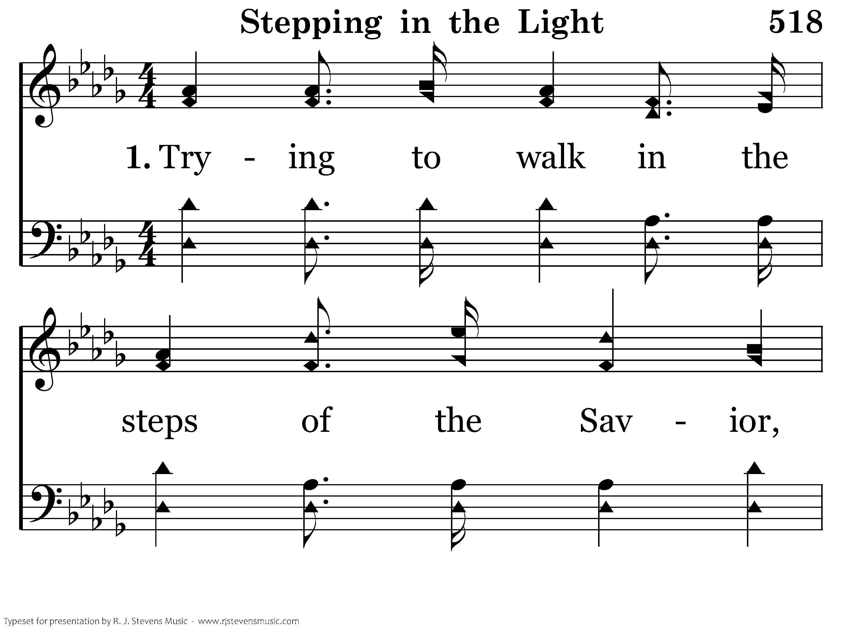
518 - Stepping In The Light - 1.1

Slide 16
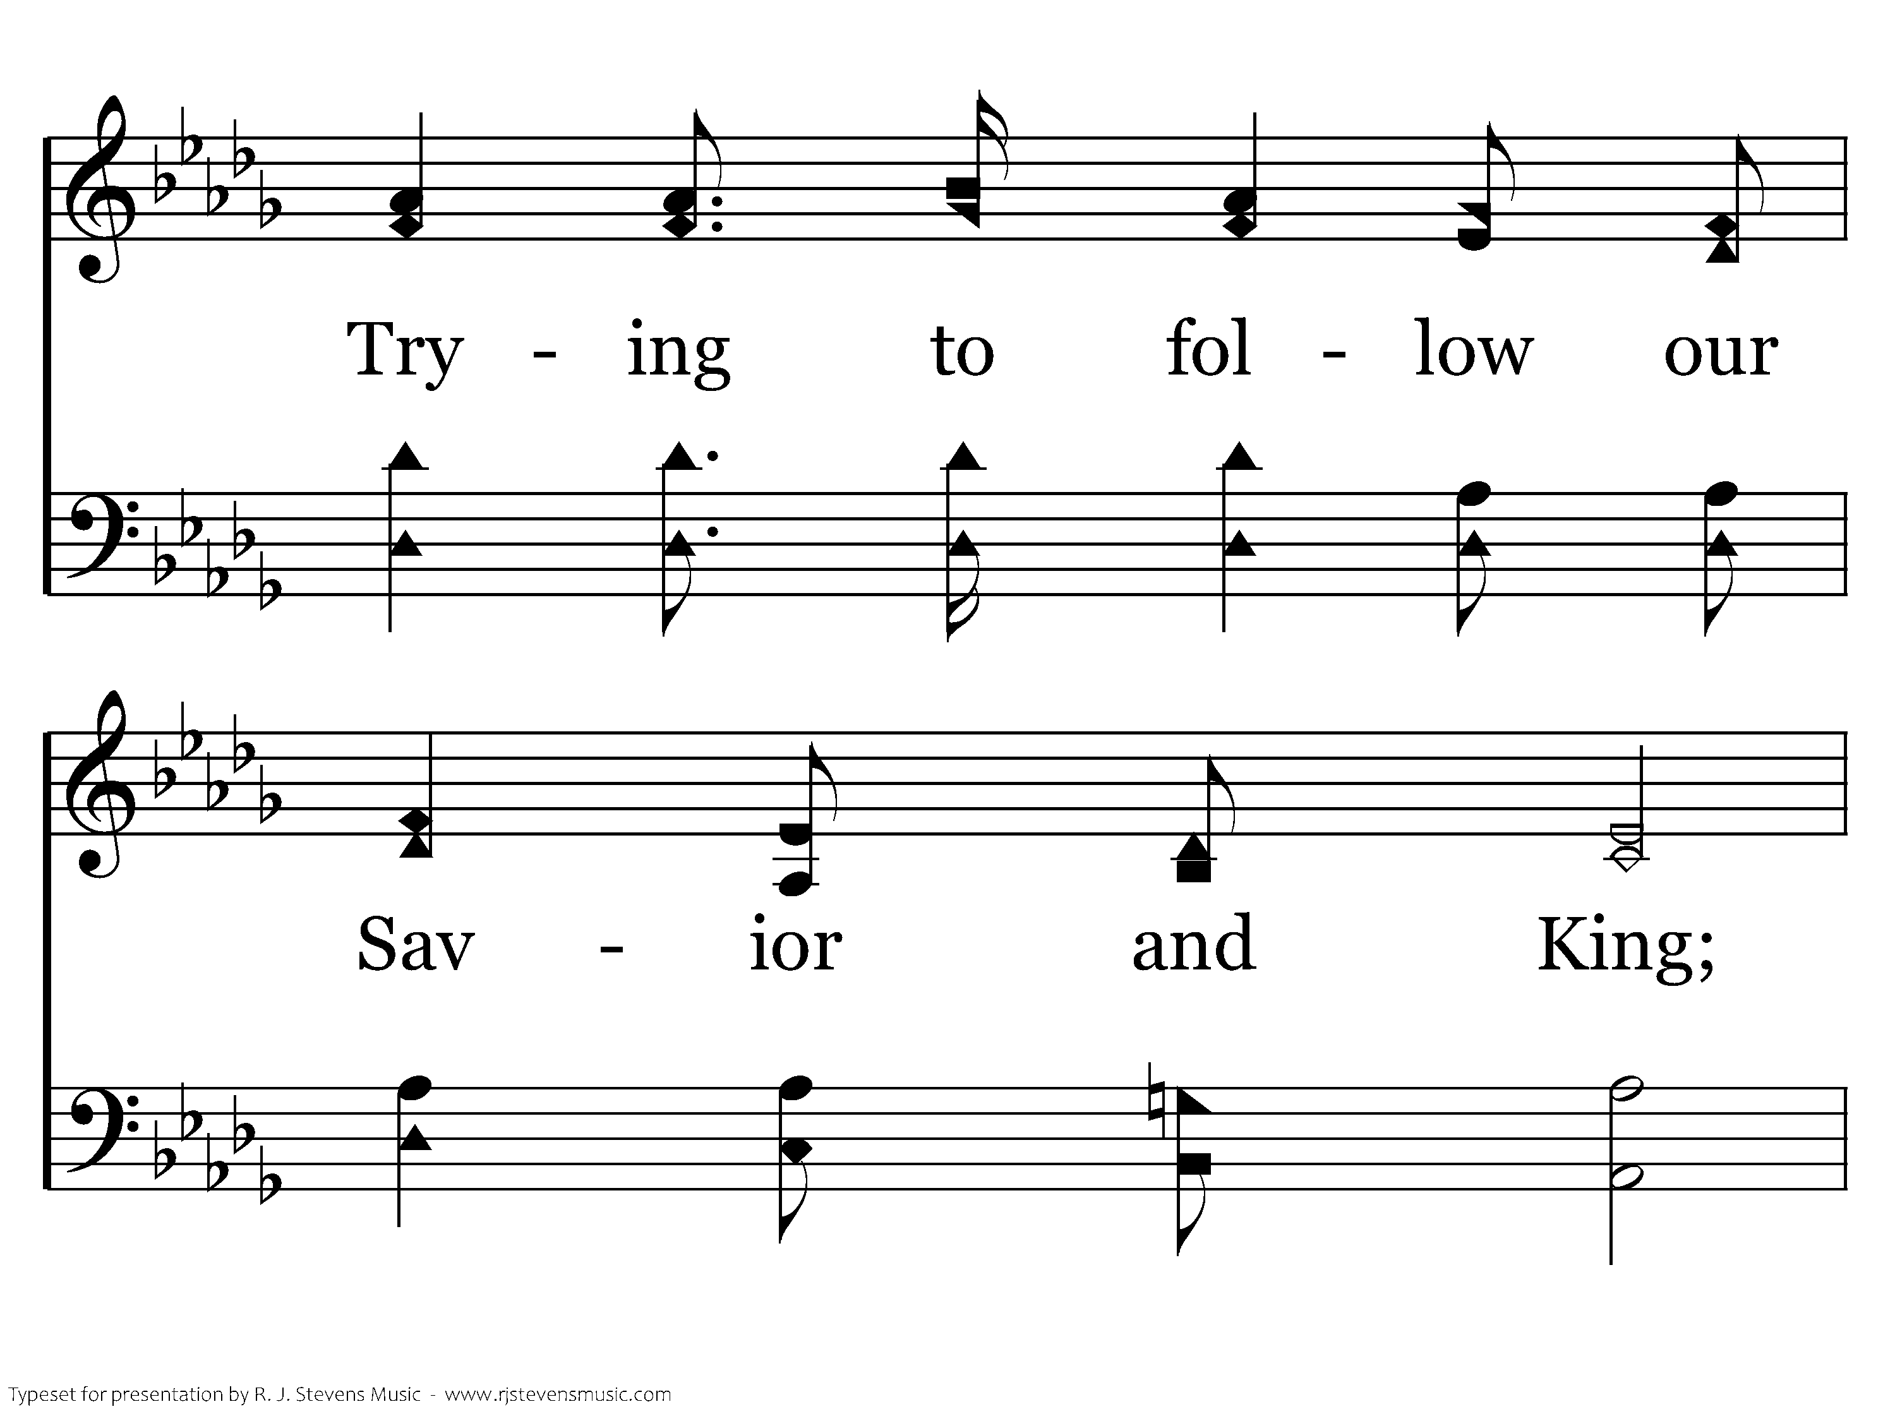
518 - Stepping In The Light - 1.2

Slide 17
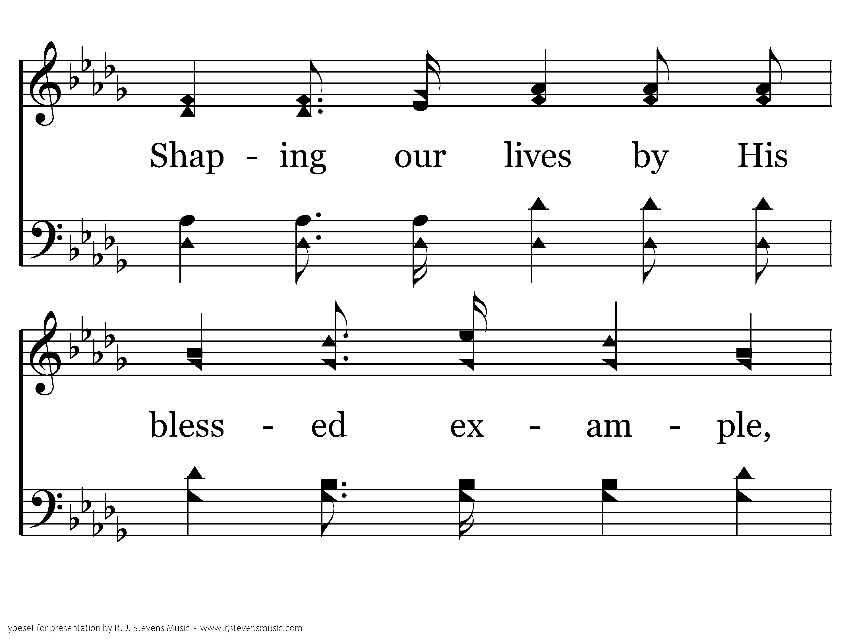
518 - Stepping In The Light - 1.3

Slide 18
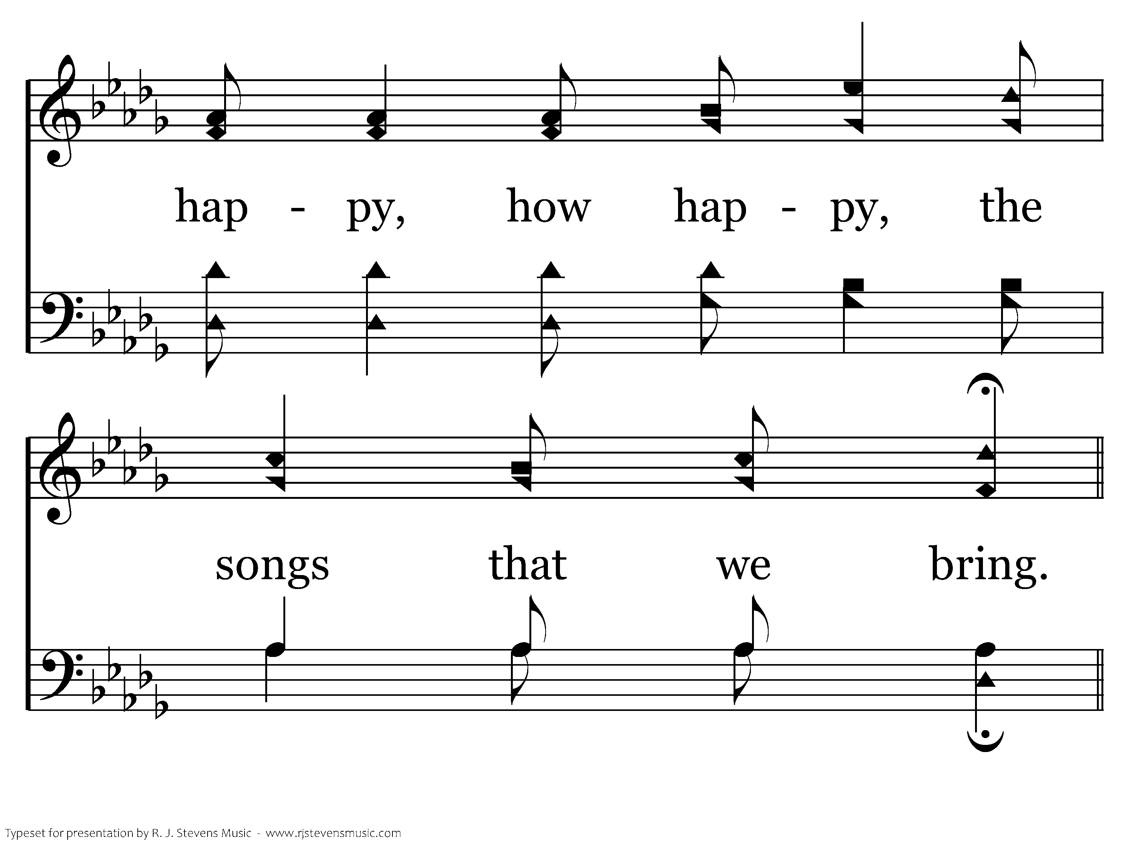
518 - Stepping In The Light - 1.4

Slide 19
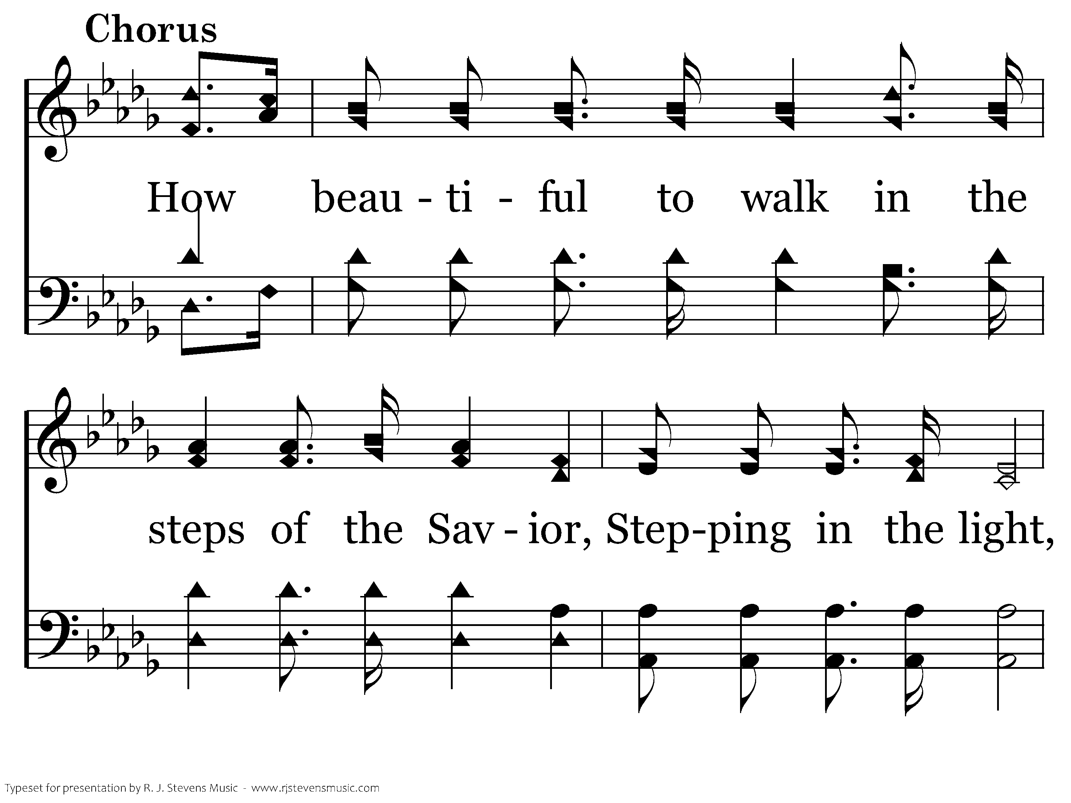
518 - Stepping In The Light - C.1

Slide 20
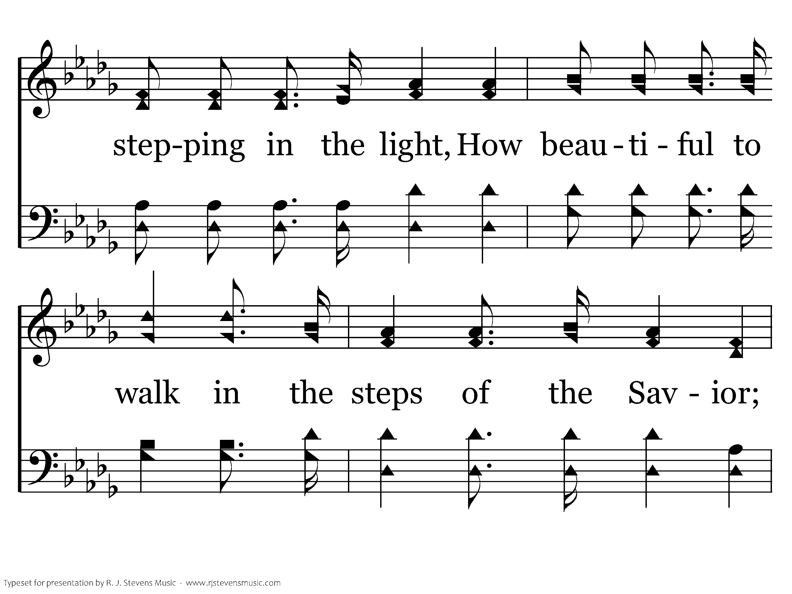
518 - Stepping In The Light - C.2

Slide 21
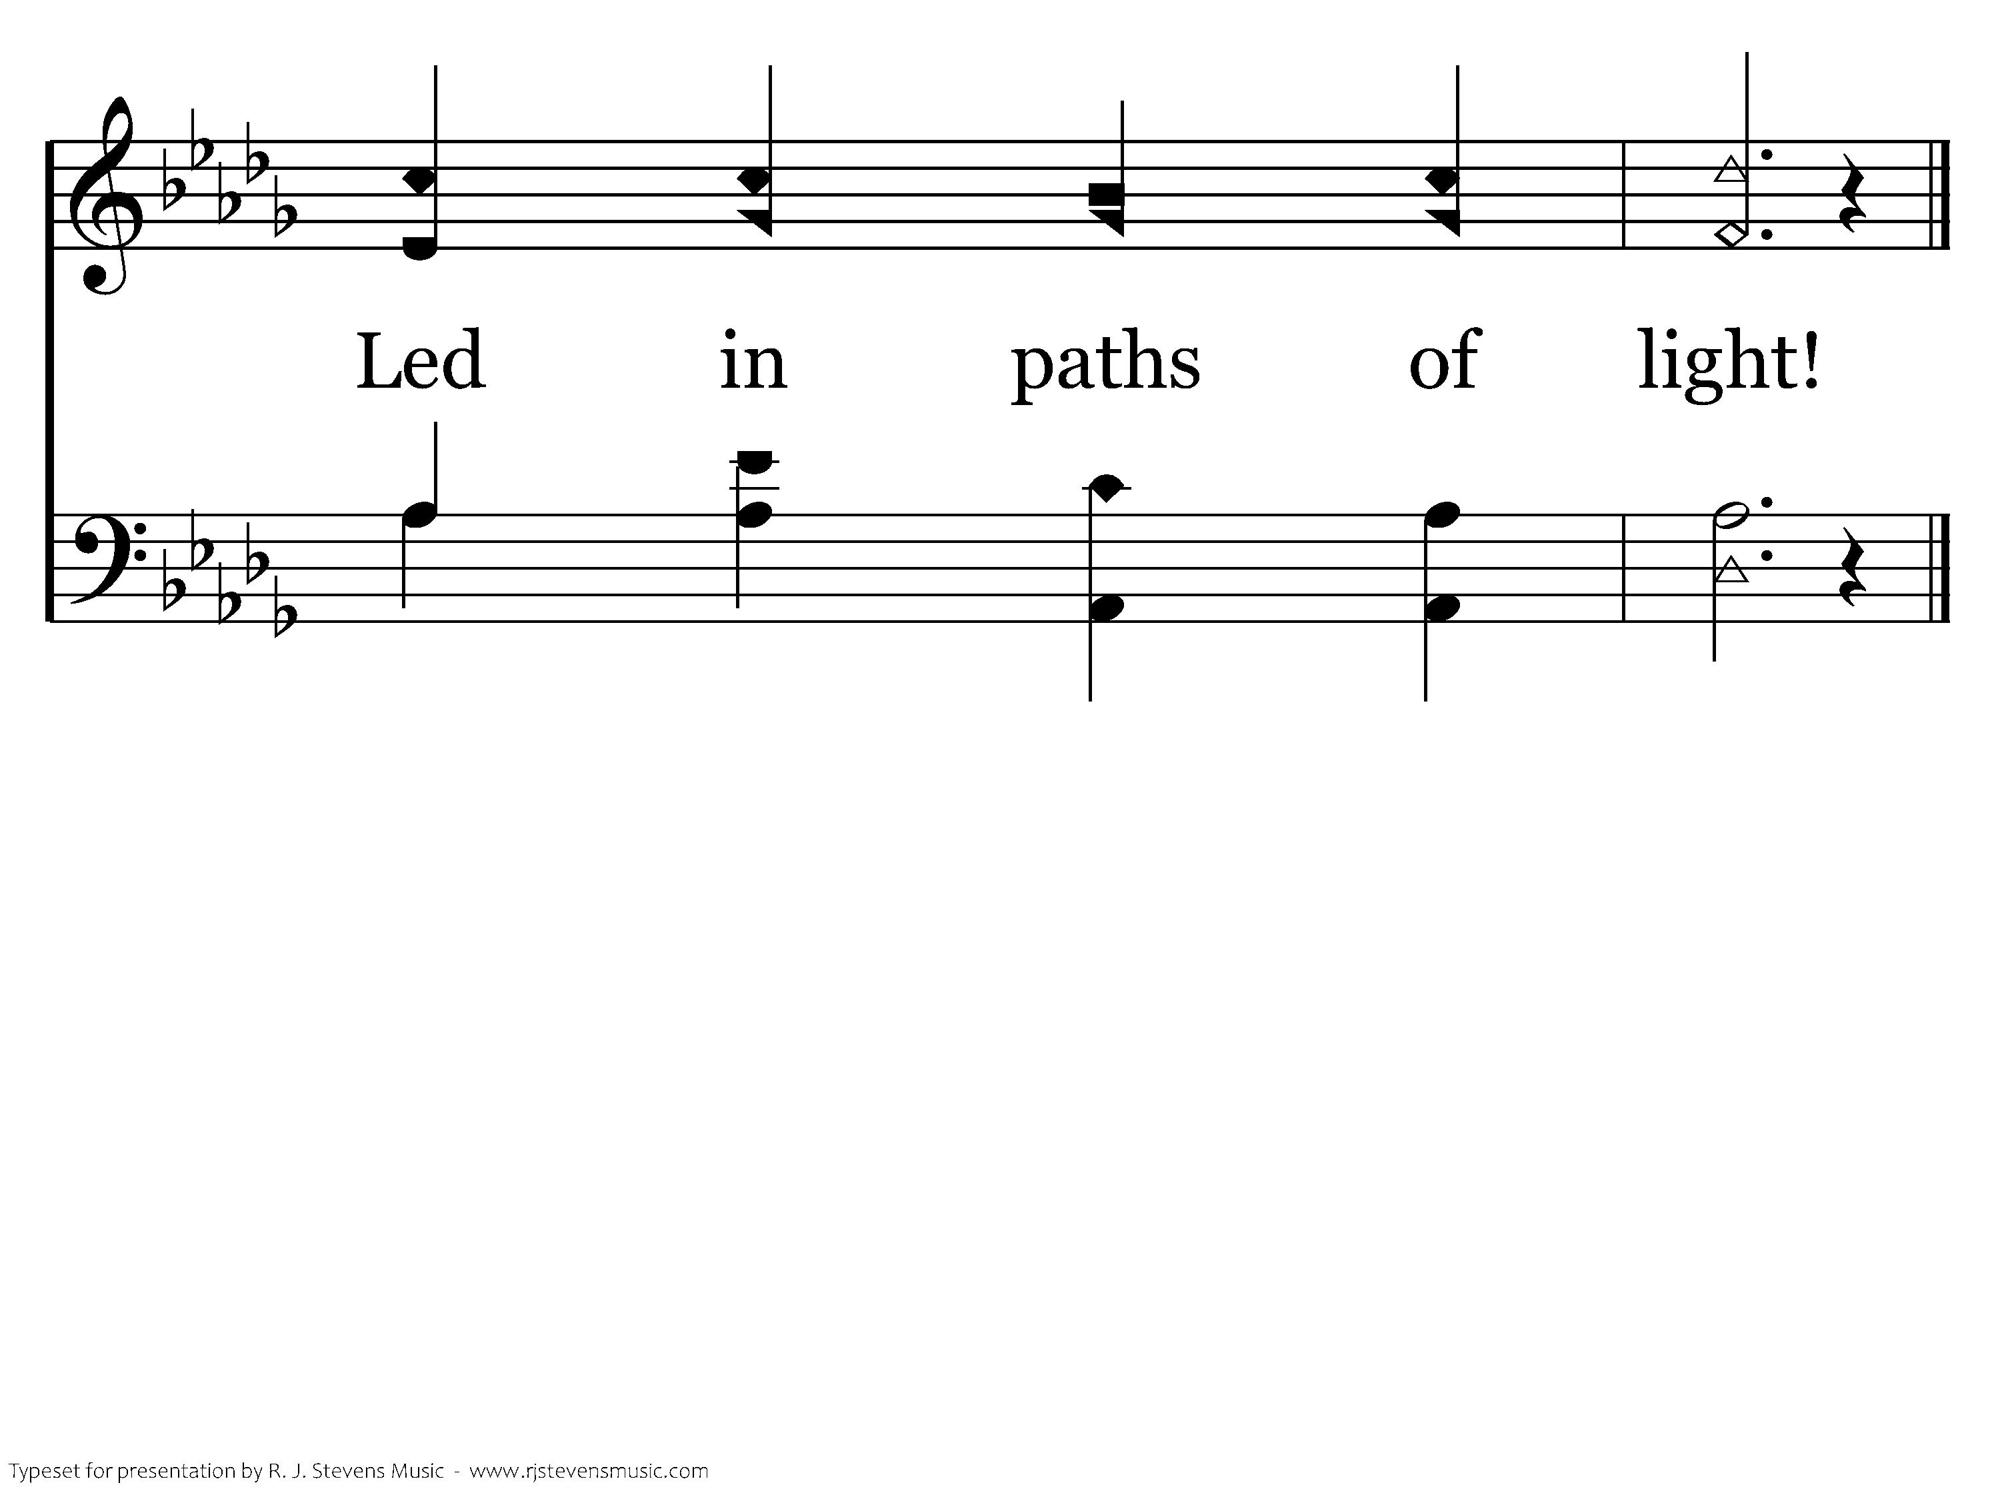
518 - Stepping In The Light - C.3
End of Verse 1

Slide 22
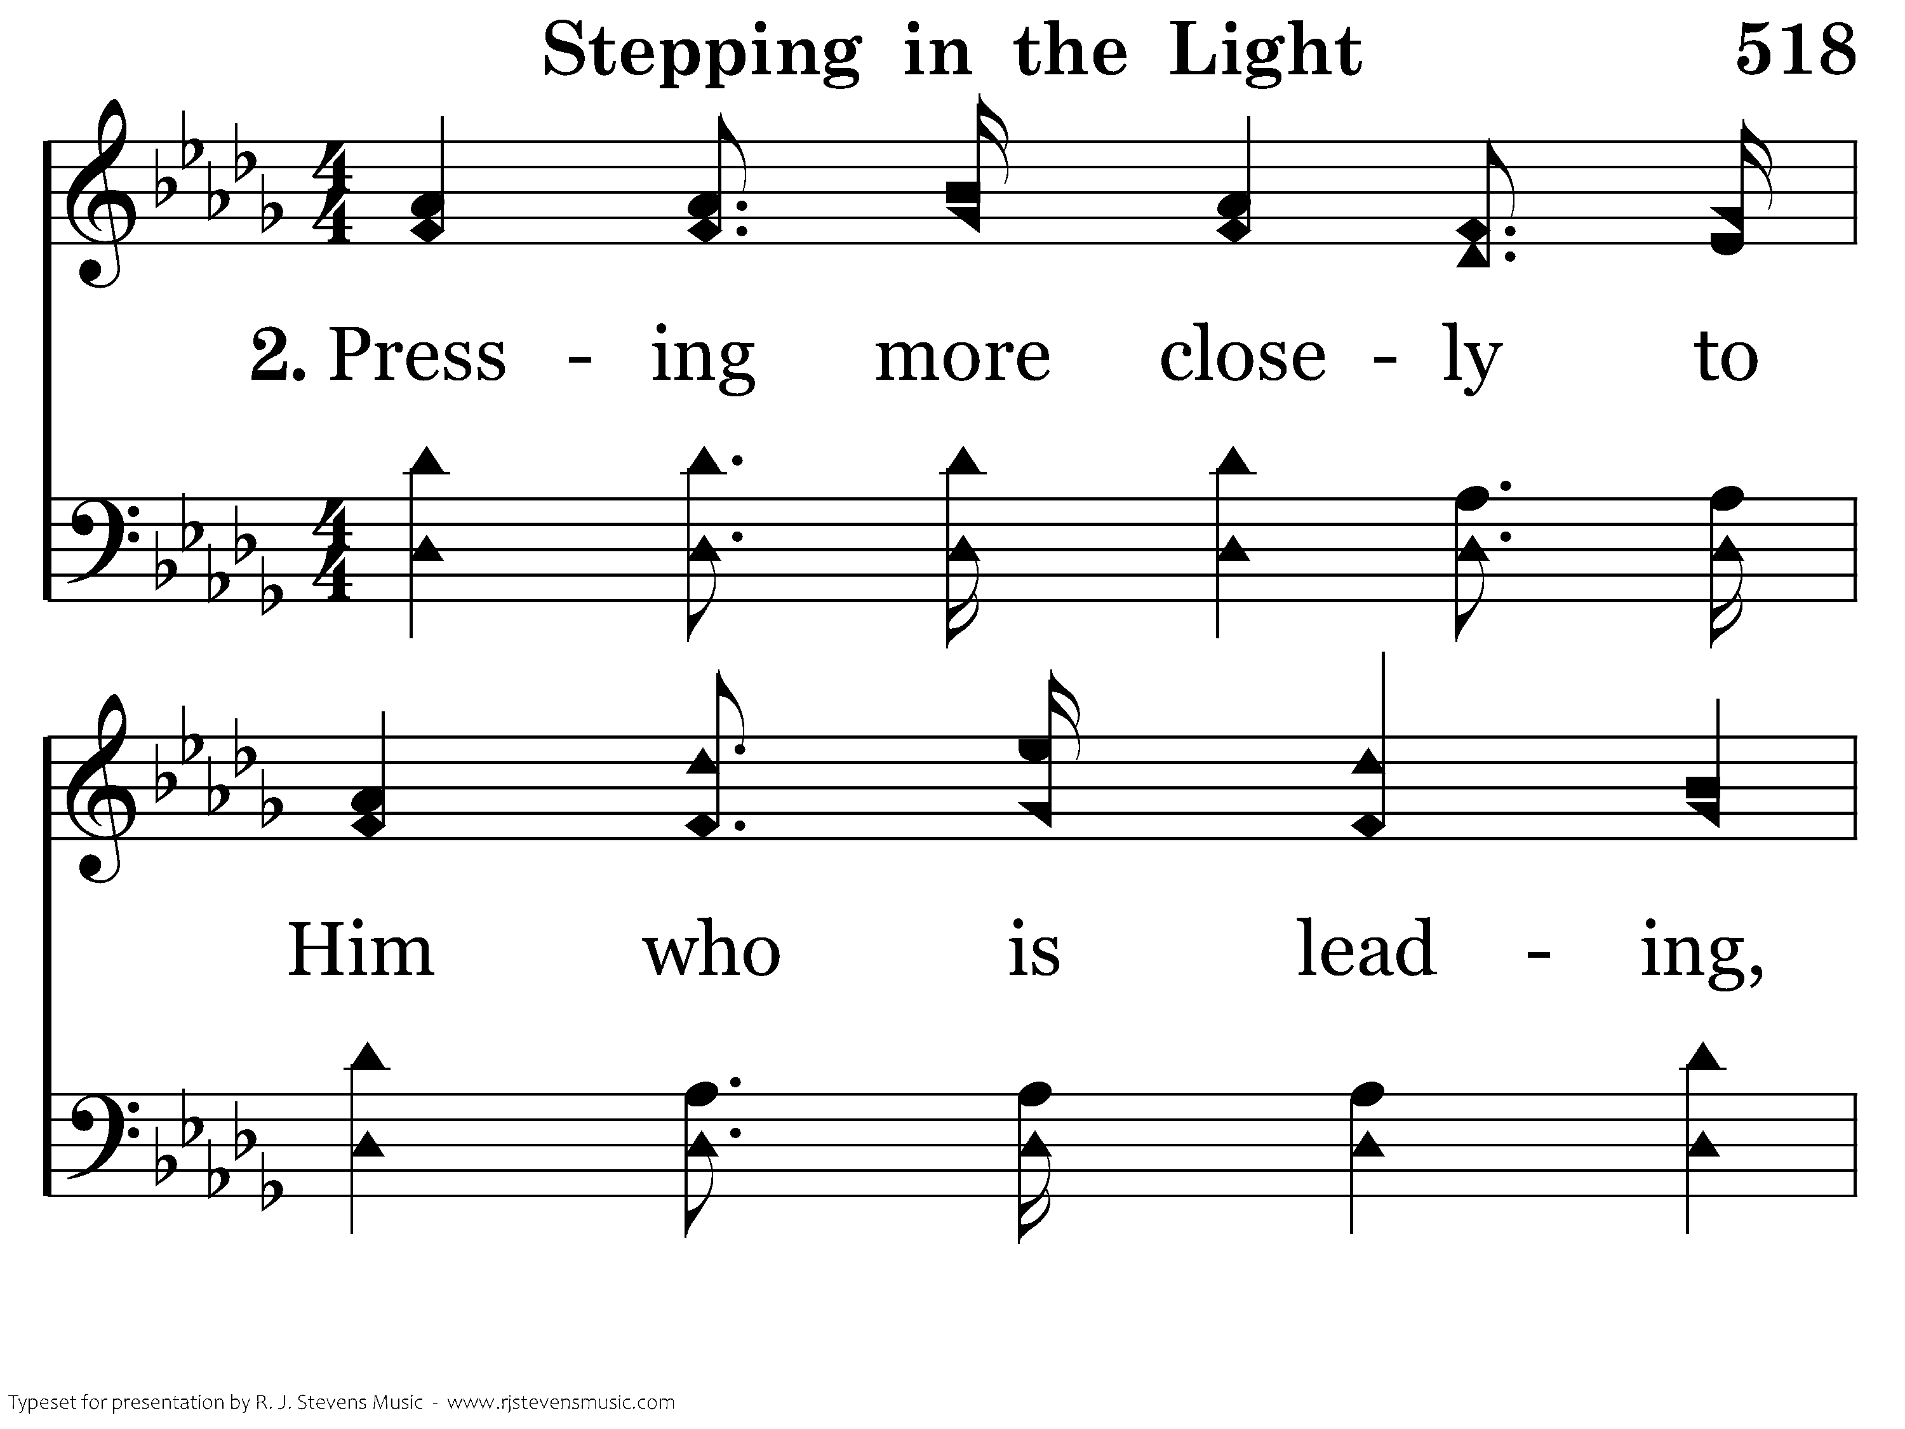
518 - Stepping In The Light - 2.1

Slide 23
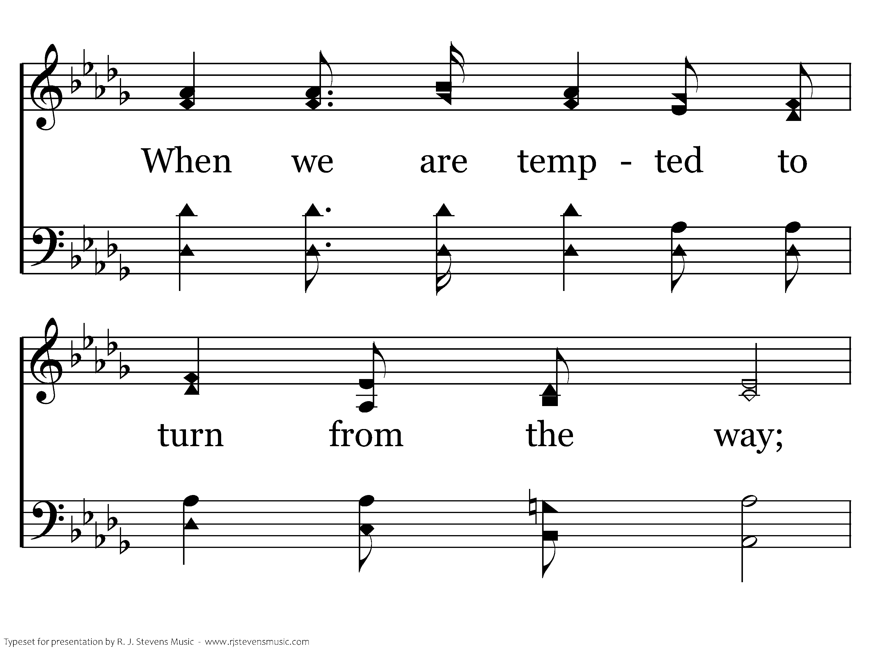
518 - Stepping In The Light - 2.2

Slide 24
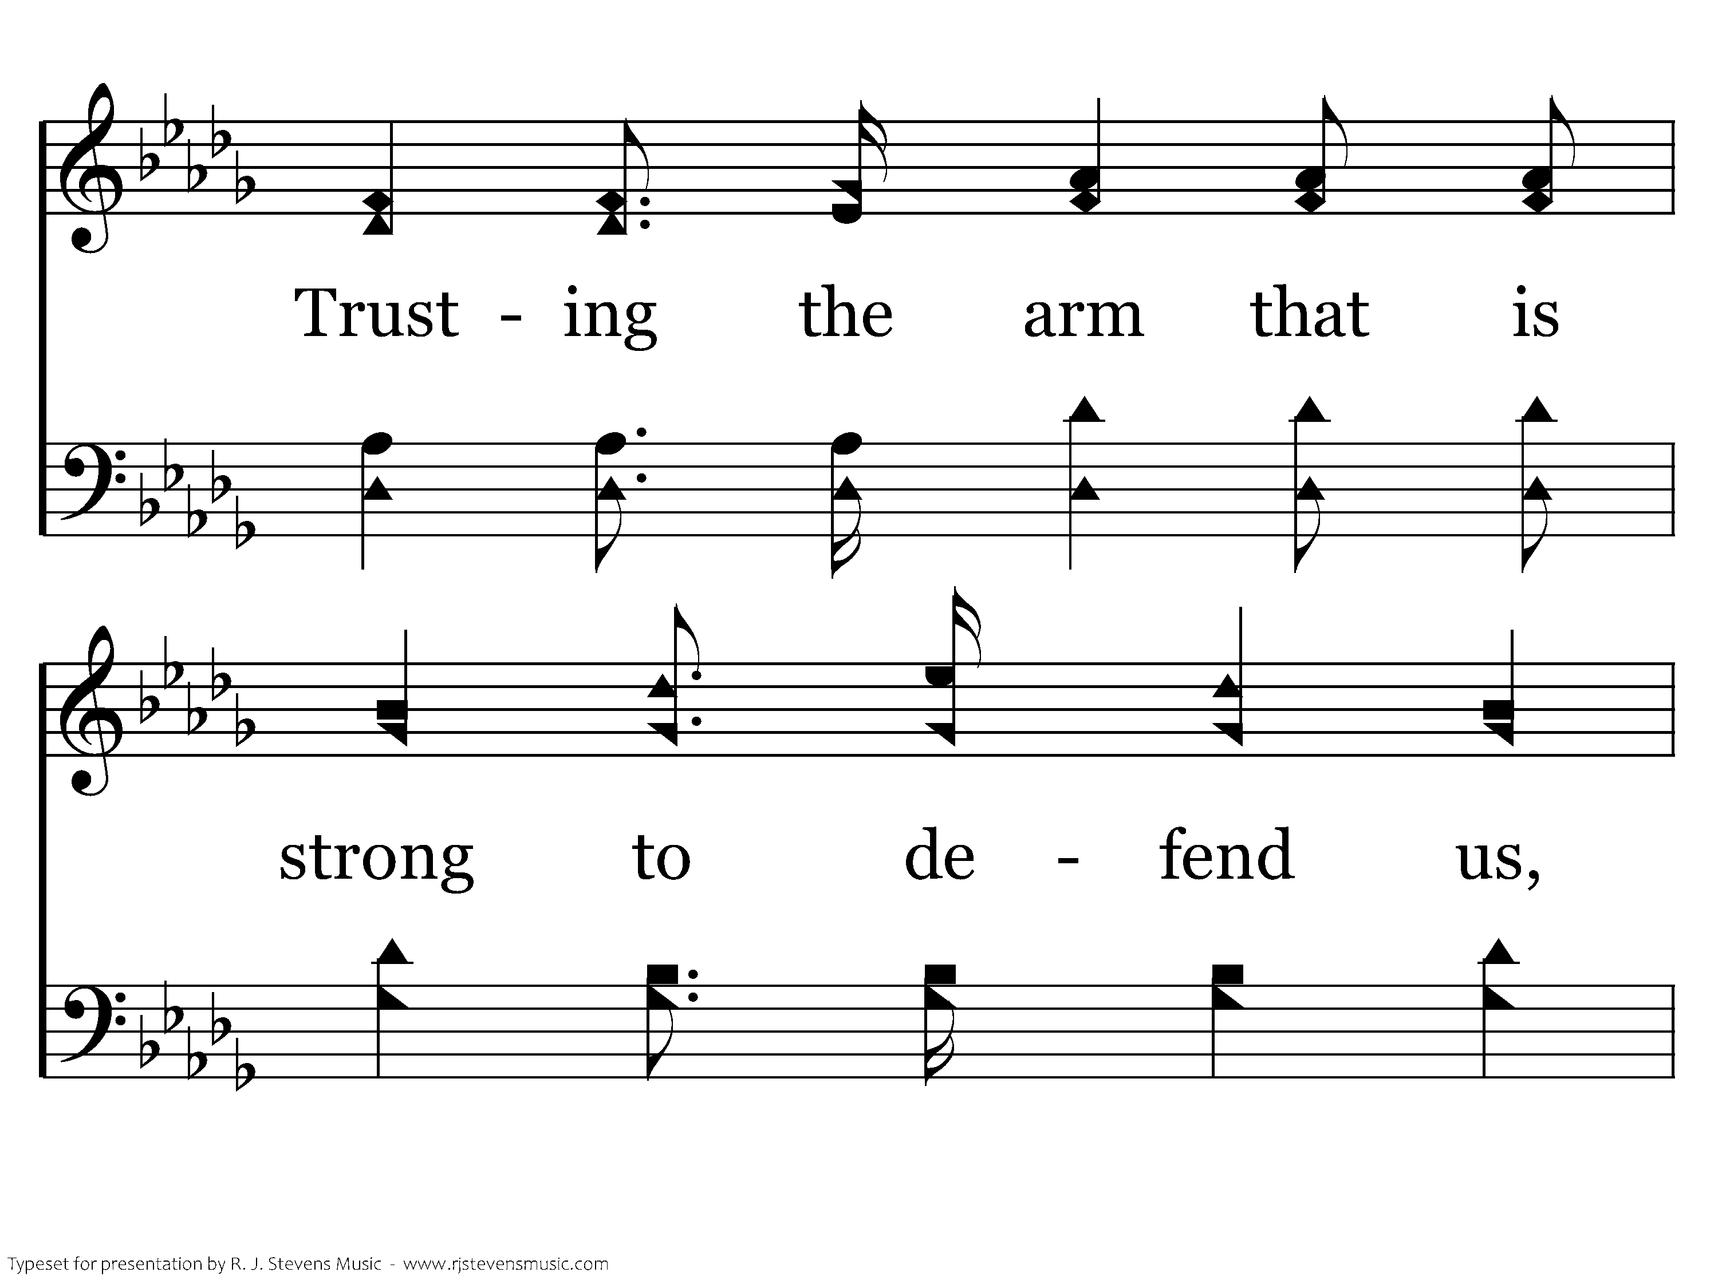
518 - Stepping In The Light - 2.3

Slide 25
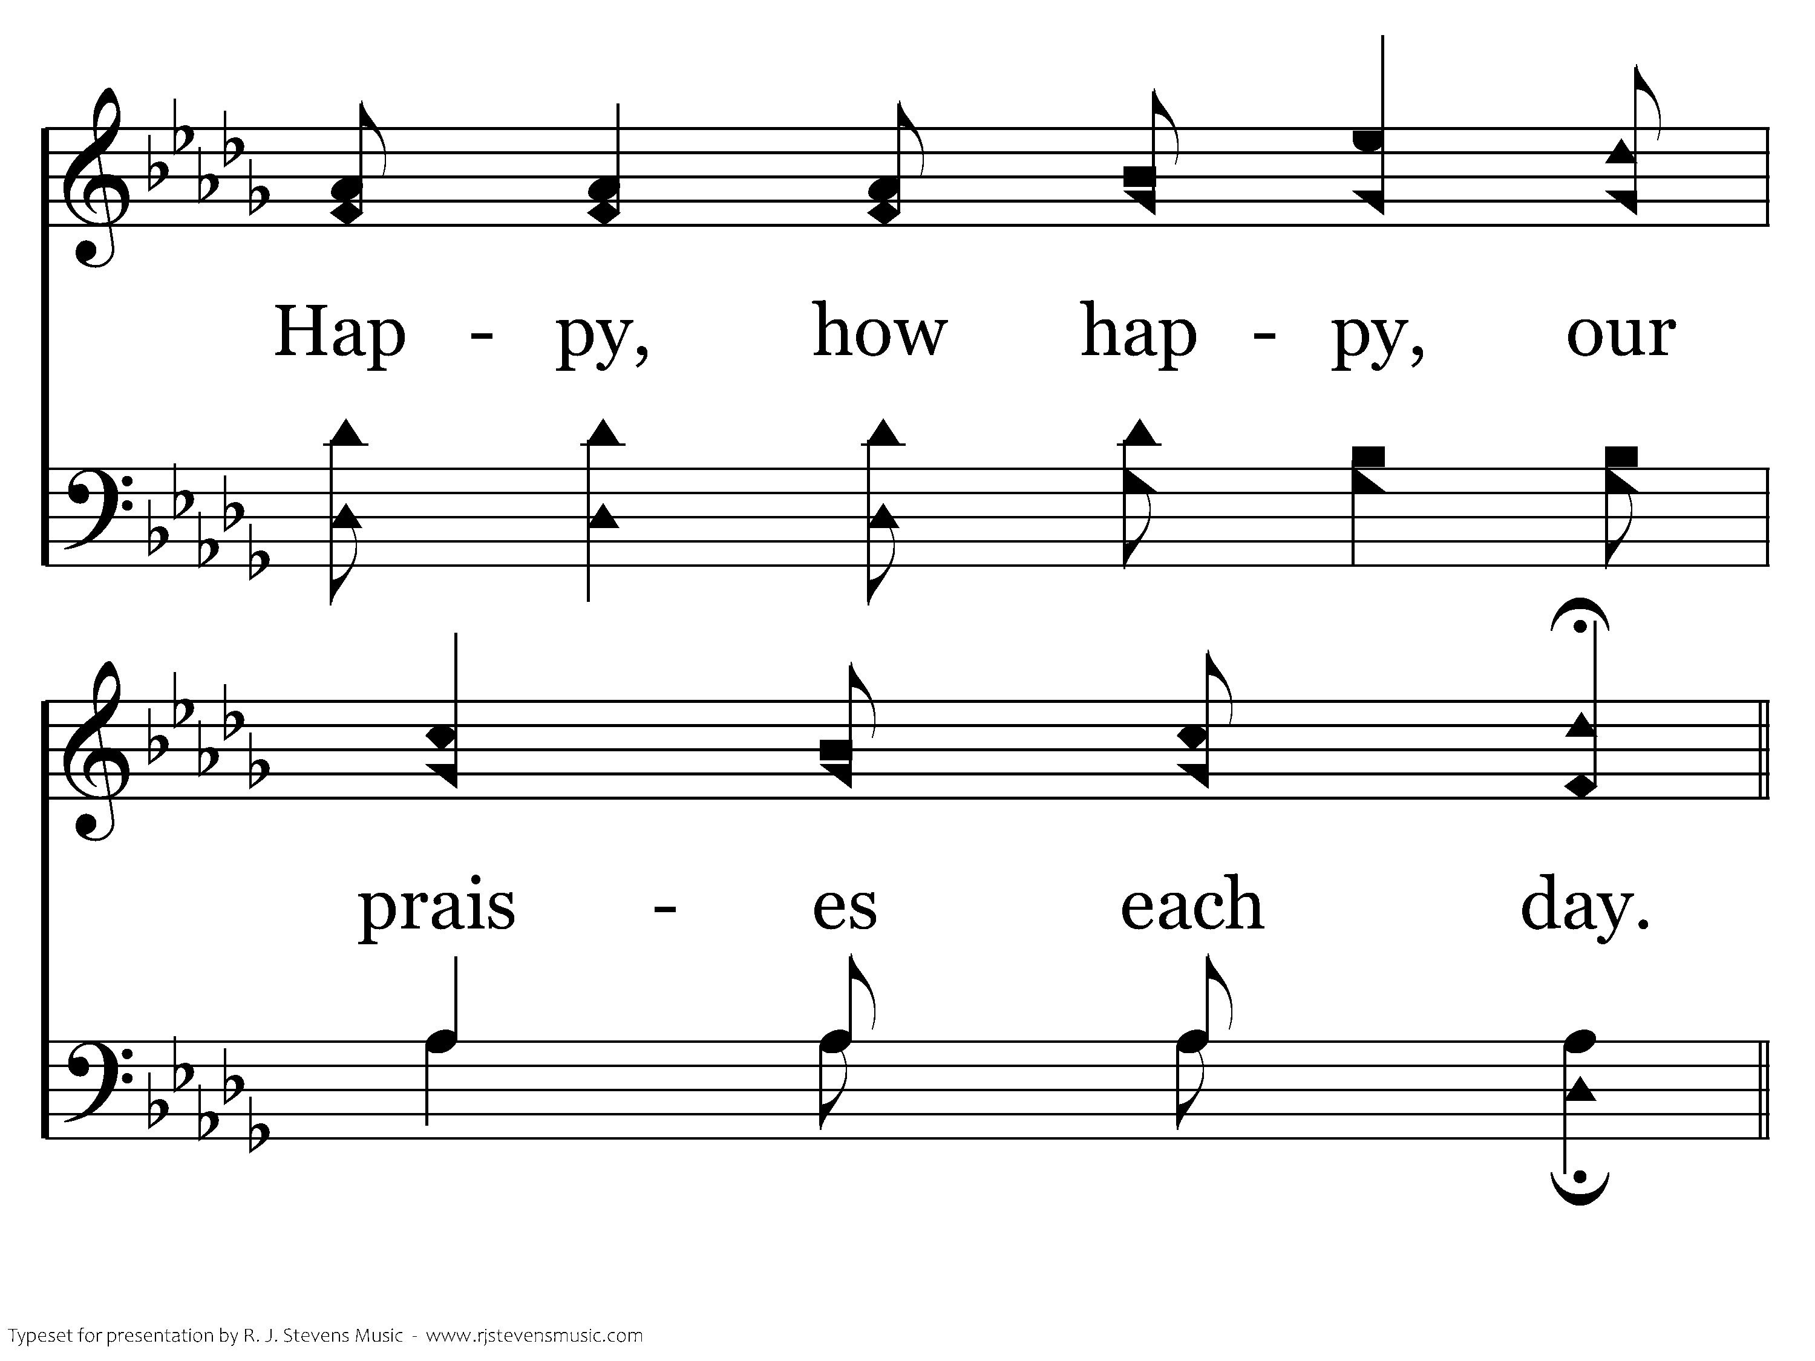
518 - Stepping In The Light - 2.4

Slide 26
518 - Stepping In The Light - C.1

Slide 27
518 - Stepping In The Light - C.2

Slide 28
518 - Stepping In The Light - C.3
End of Verse 2

Slide 29

518 - Stepping In The Light - 3.1

Slide 30
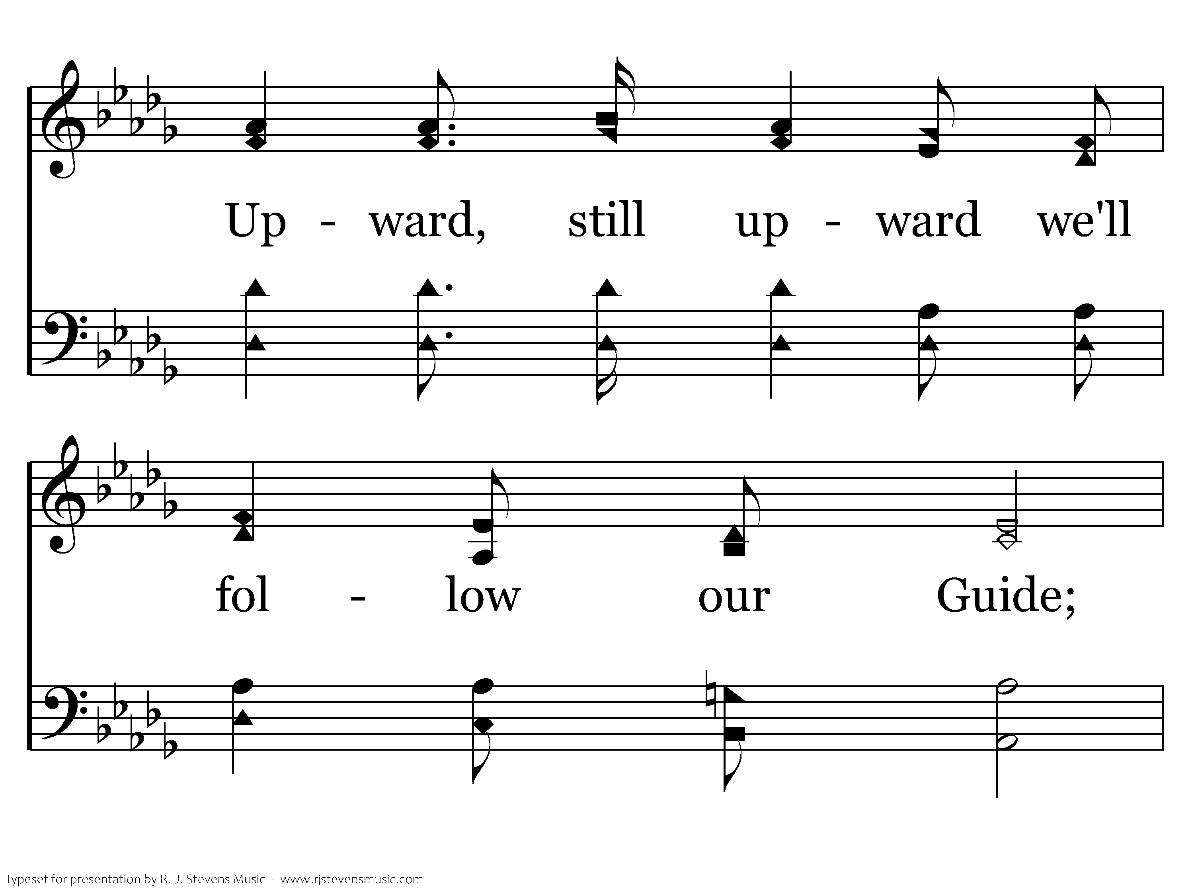
518 - Stepping In The Light - 3.2

Slide 31
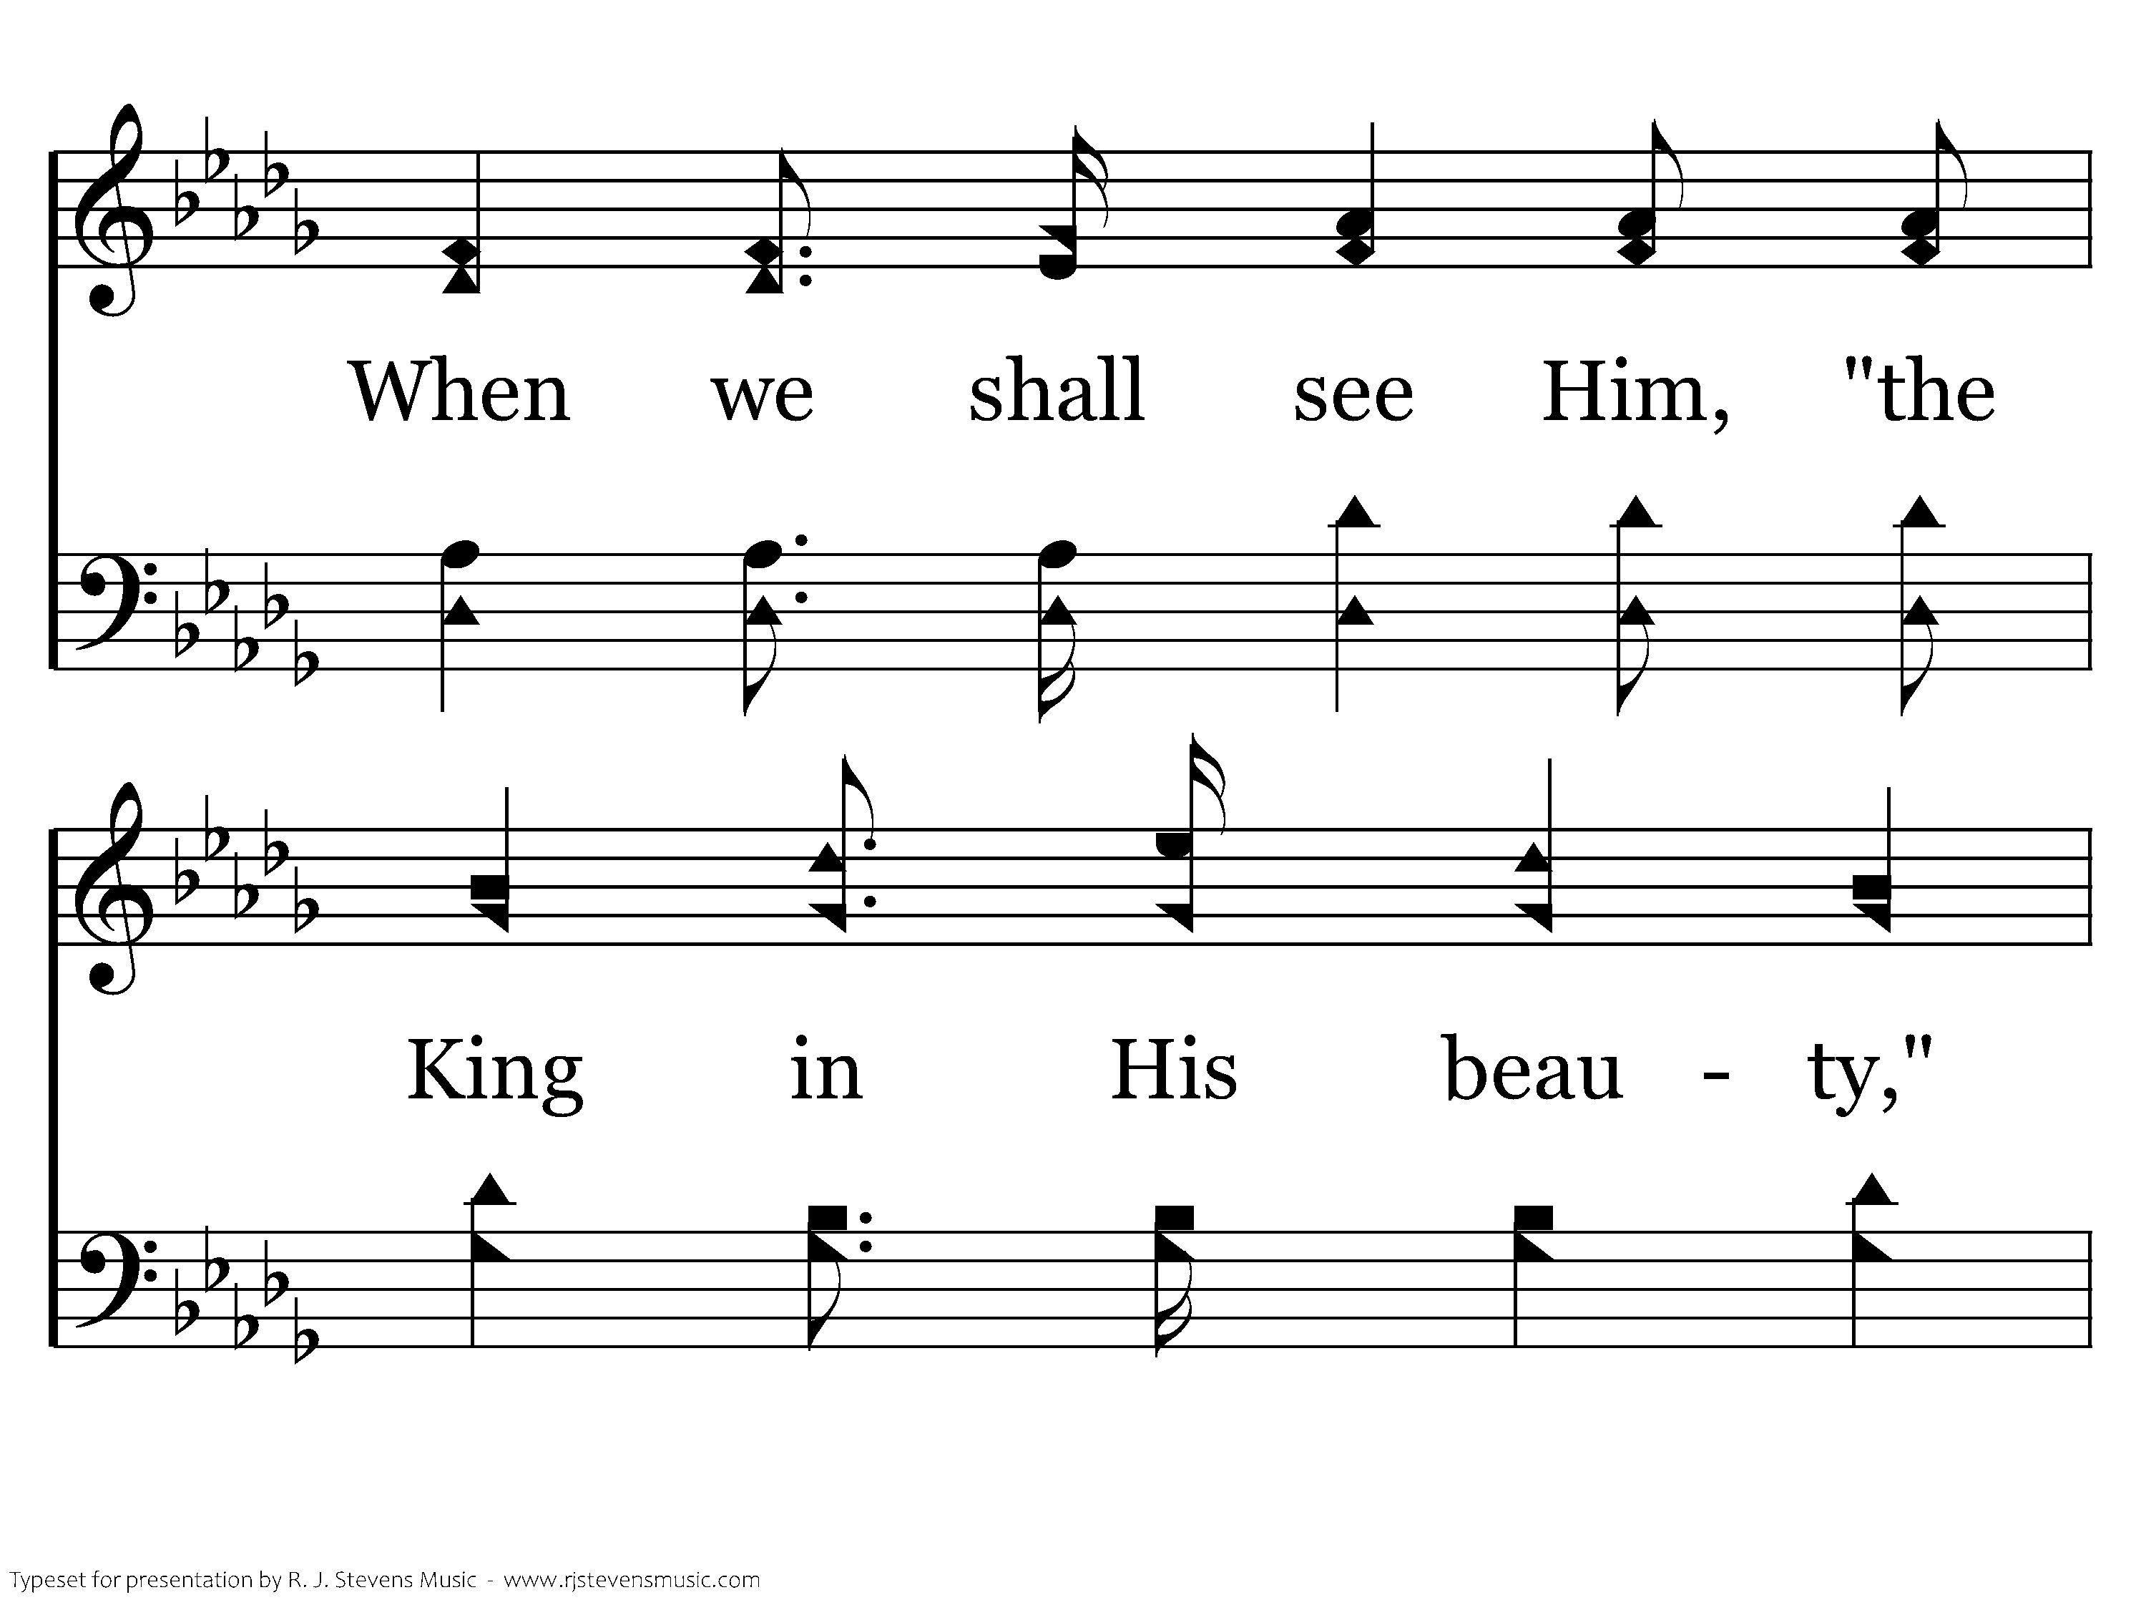
518 - Stepping In The Light - 3.3

Slide 32
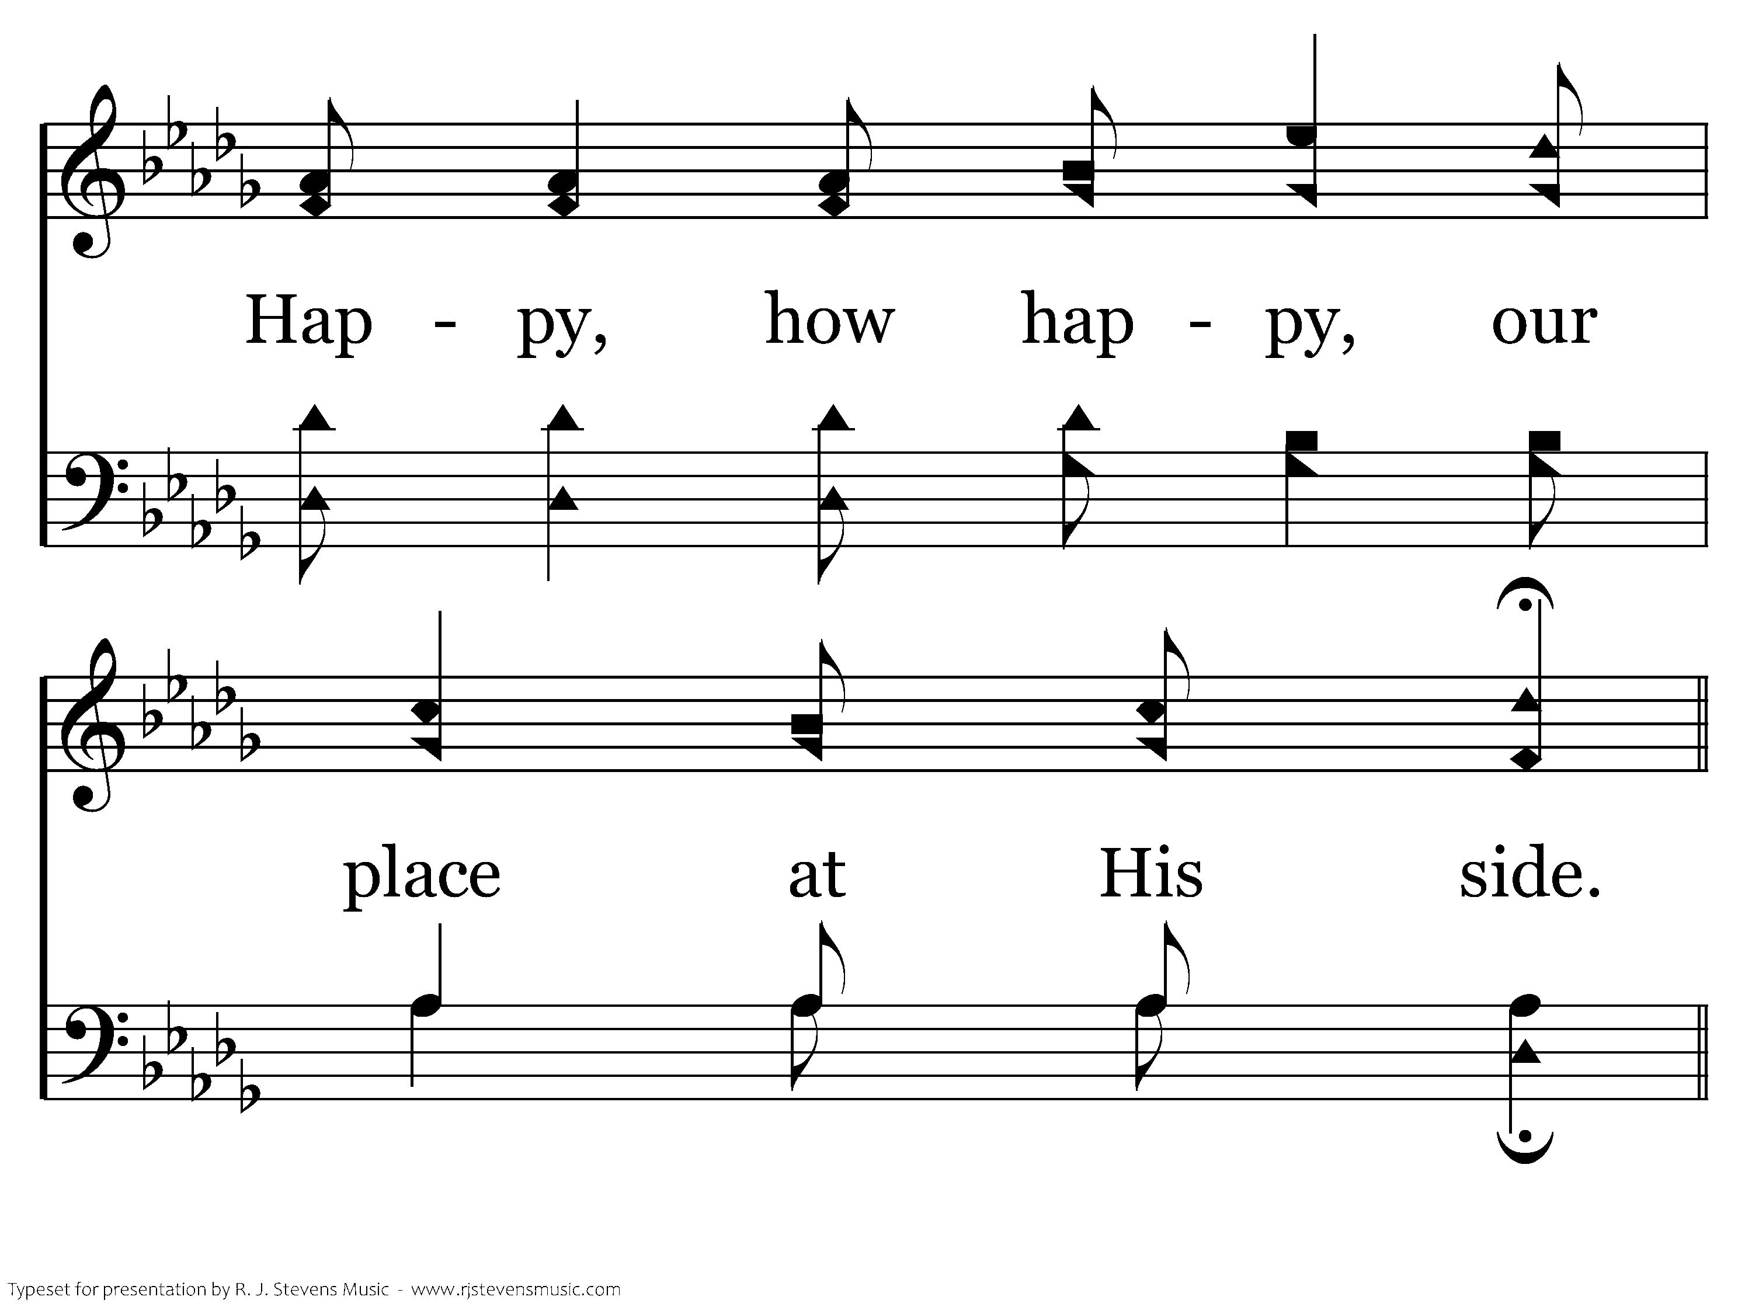
518 - Stepping In The Light - 3.4

Slide 33
518 - Stepping In The Light - C.1

Slide 34
518 - Stepping In The Light - C.2

Slide 35
518 - Stepping In The Light - C.3
End of Song

Slide 37

FIRST
JOHN
LAWRENCEVILLE
11.20.22

Slide 38
[1] That which was from the beginning, which we have heard, which we have seen with our eyes, which we looked upon and have touched with our hands, concerning the word of life—[2] the life was made manifest, and we have seen it, and testify to it and proclaim to you the eternal life, which was with the Father and was made manifest to us—[3] that which we have seen and heard we proclaim also to you, so that you too may have fellowship with us; and indeed our fellowship is with the Father and with his Son Jesus Christ. [4] And we are writing these things so that our joy may be complete.

Slide 39
[5] This is the message we have heard from him and proclaim to you, that God is light, and in him is no darkness at all. [6] If we say we have fellowship with him while we walk in darkness, we lie and do not practice the truth. [7] But if we walk in the light, as he is in the light, we have fellowship with one another, and the blood of Jesus his Son cleanses us from all sin. [8] If we say we have no sin, we deceive ourselves, and the truth is not in us. [9] If we confess our sins, he is faithful and just to forgive us our sins and to cleanse us from all unrighteousness. [10] If we say we have not sinned, we make him a liar, and his word is not in us.

Slide 40
[1] My little children, I am writing these things to you so that you may not sin. But if anyone does sin, we have an advocate with the Father, Jesus Christ the righteous. [2] He is the propitiation for our sins, and not for ours only but also for the sins of the whole world. [3] And by this we know that we have come to know him, if we keep his commandments. [4] Whoever says “I know him” but does not keep his commandments is a liar, and the truth is not in him, [5] but whoever keeps his word, in him truly the love of God is perfected. By this we may know that we are in him: [6] whoever says he abides in him ought to walk in the same way in which he walked.

Slide 41
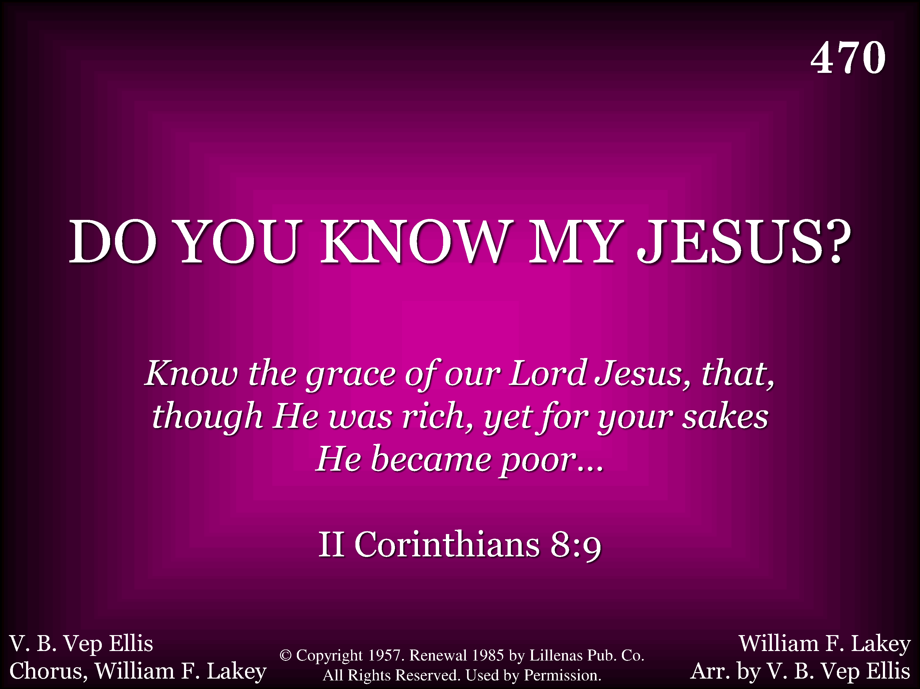
470 - Do You Know My Jesus - Title

Slide 42
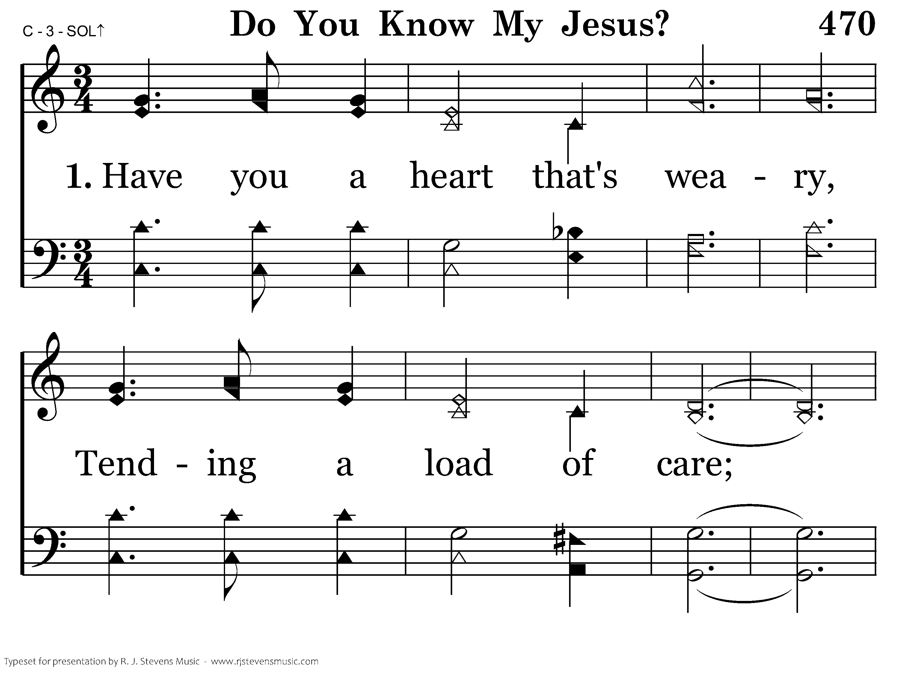
470 - Do You Know My Jesus - 1.1

Slide 43
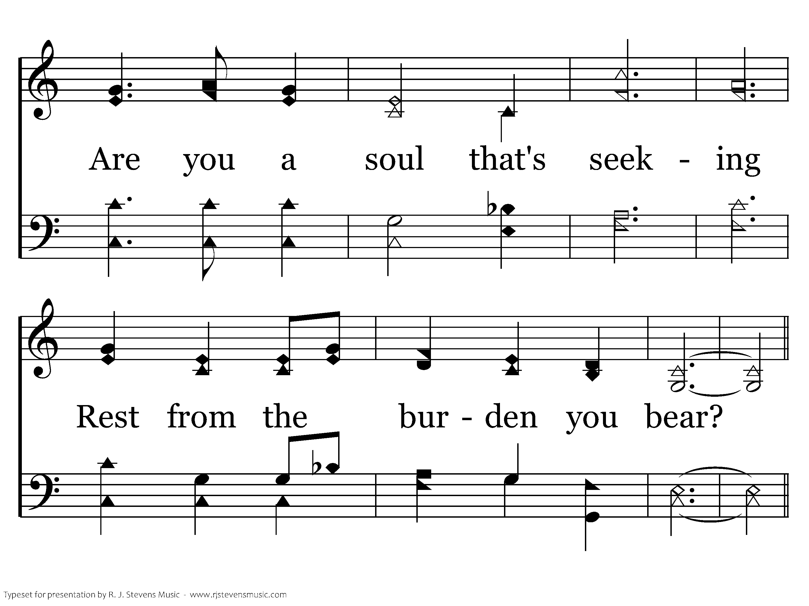
470 - Do You Know My Jesus - 1.2

Slide 44
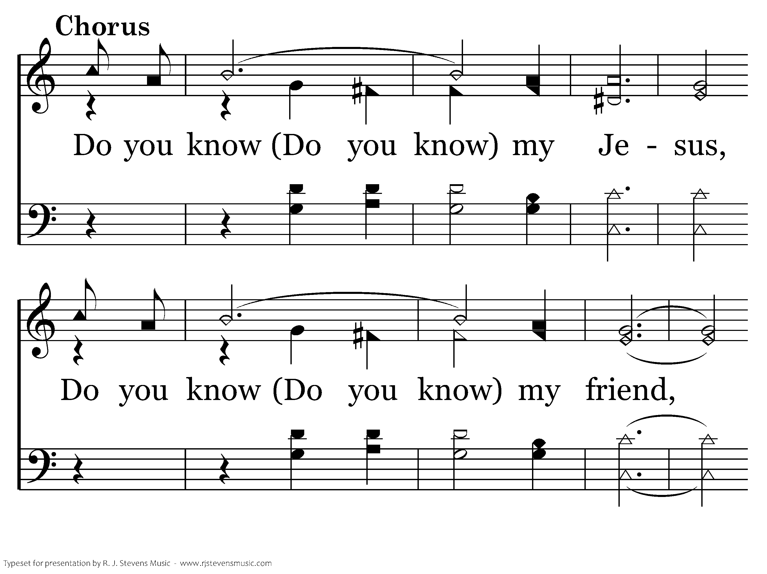
470 - Do You Know My Jesus - C.1

Slide 45
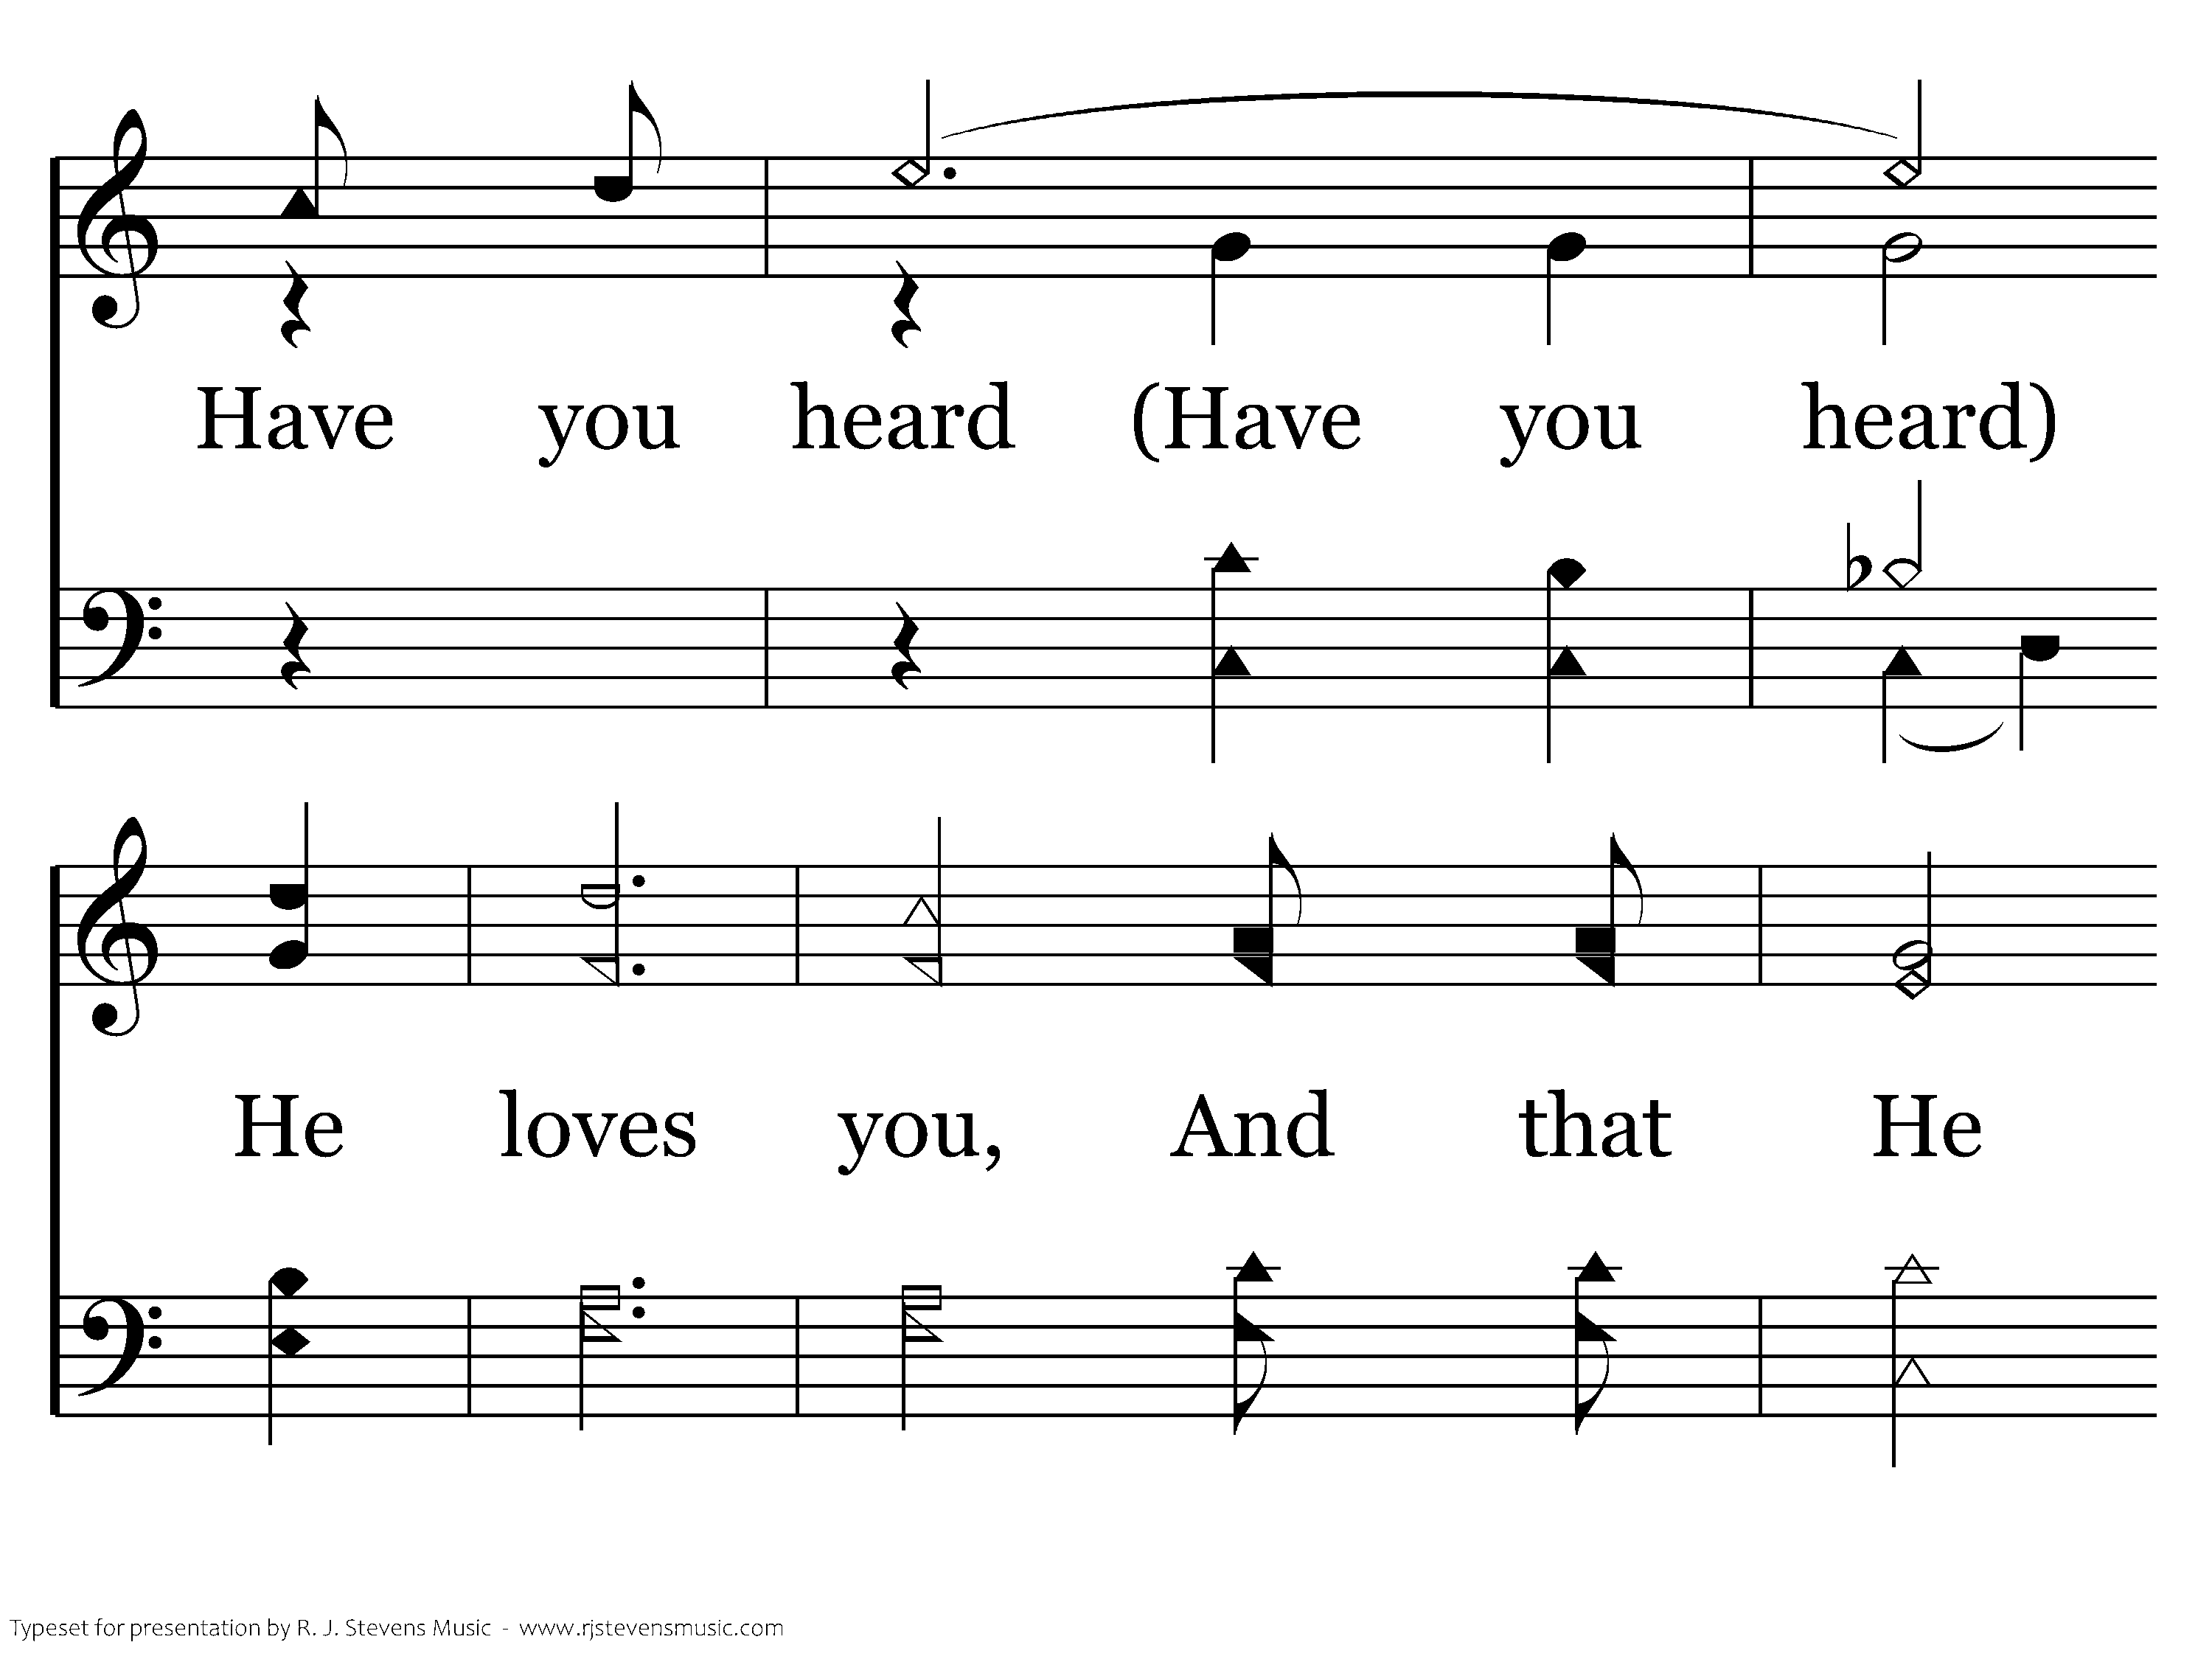
470 - Do You Know My Jesus - C.2

Slide 46
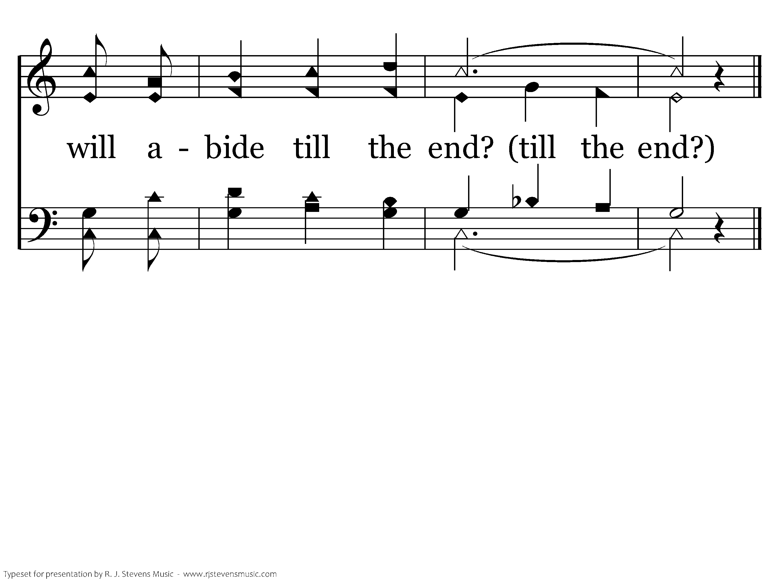
470 - Do You Know My Jesus - C.3
End of Verse 1

Slide 47
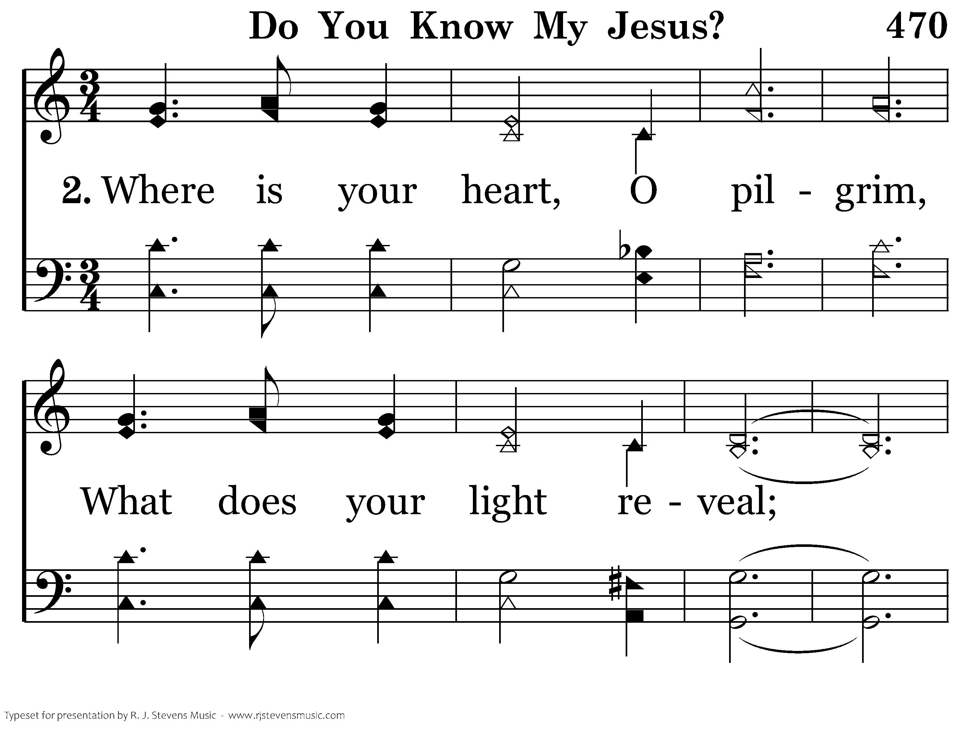
470 - Do You Know My Jesus - 2.1

Slide 48
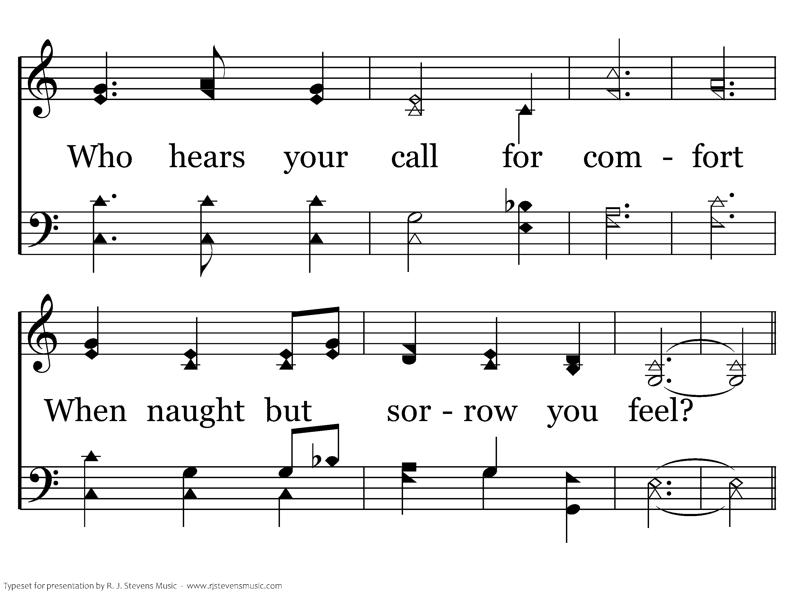
470 - Do You Know My Jesus - 2.2

Slide 49
470 - Do You Know My Jesus - C.1

Slide 50
470 - Do You Know My Jesus - C.2

Slide 51
470 - Do You Know My Jesus - C.3
End of Verse 2

Slide 52
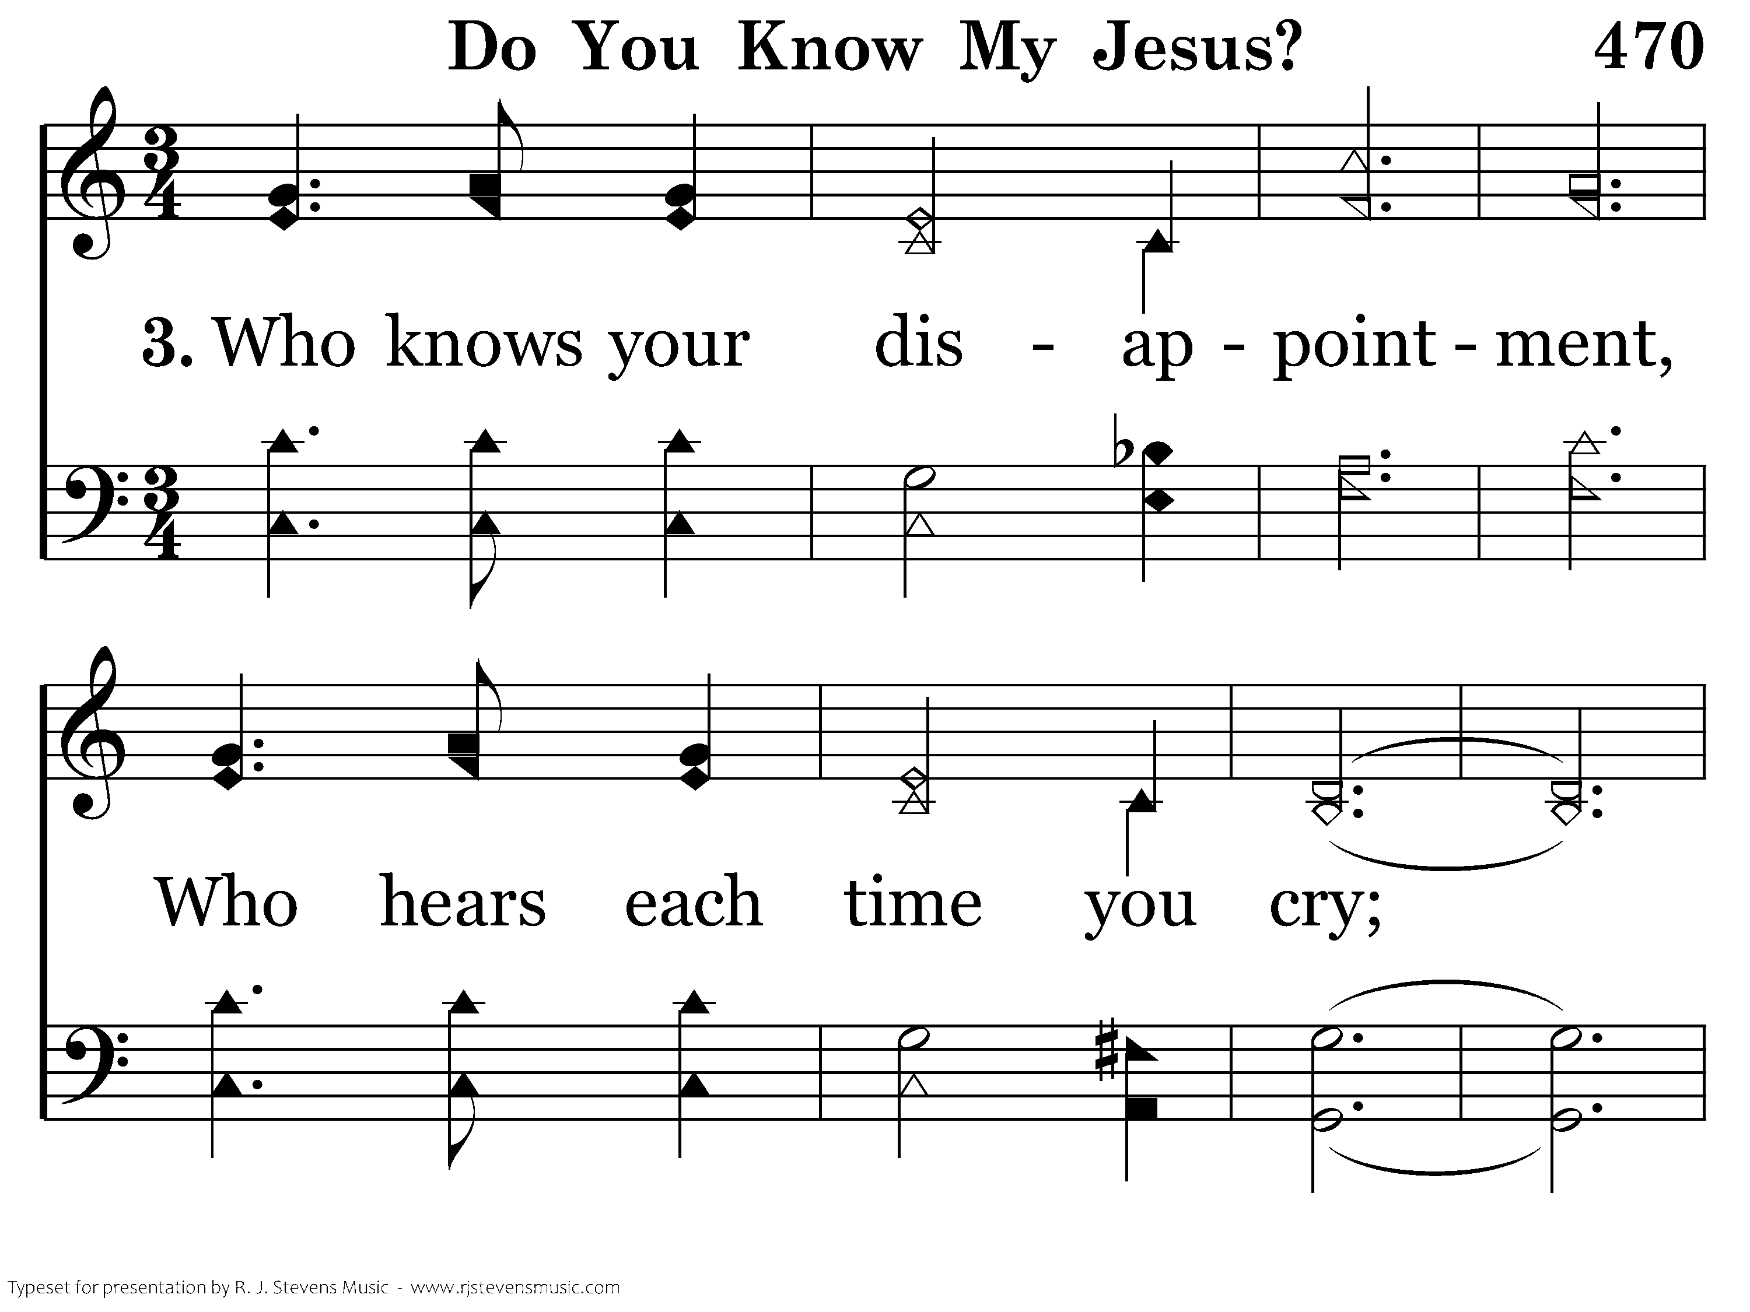
470 - Do You Know My Jesus - 3.1

Slide 53
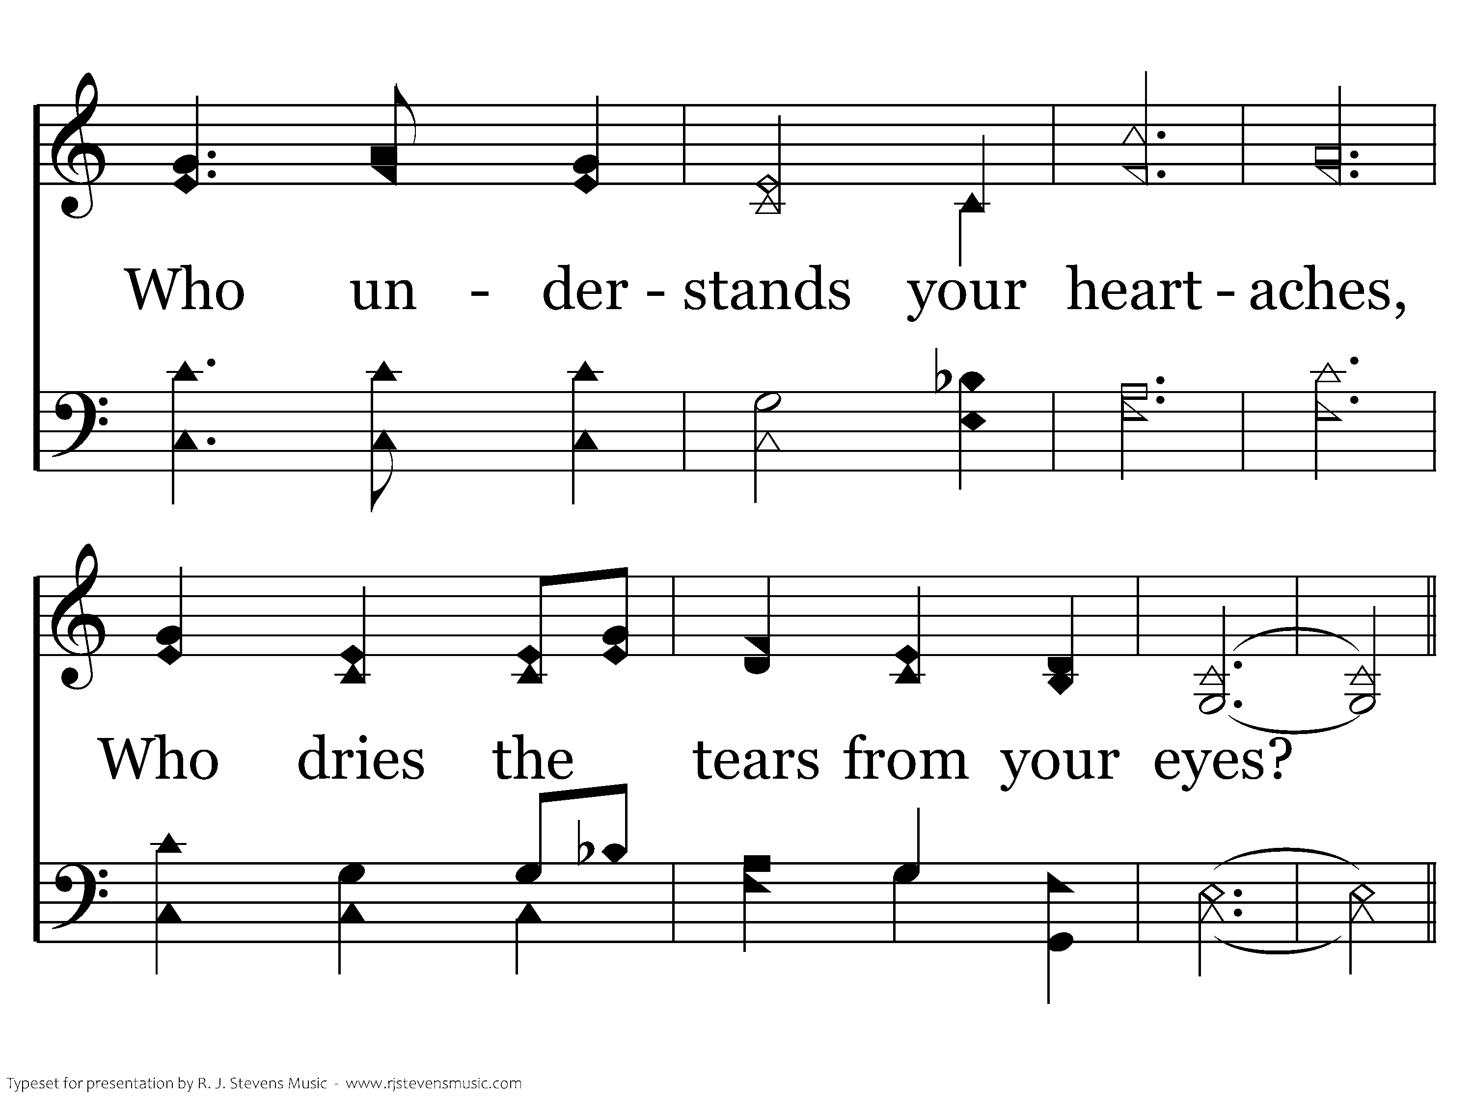
470 - Do You Know My Jesus - 3.2

Slide 54
470 - Do You Know My Jesus - C.1

Slide 55
470 - Do You Know My Jesus - C.2

Slide 56
470 - Do You Know My Jesus - C.3
End of Song

Slide 57

159 - When My Love To Christ Grows Weak - Title

Slide 58
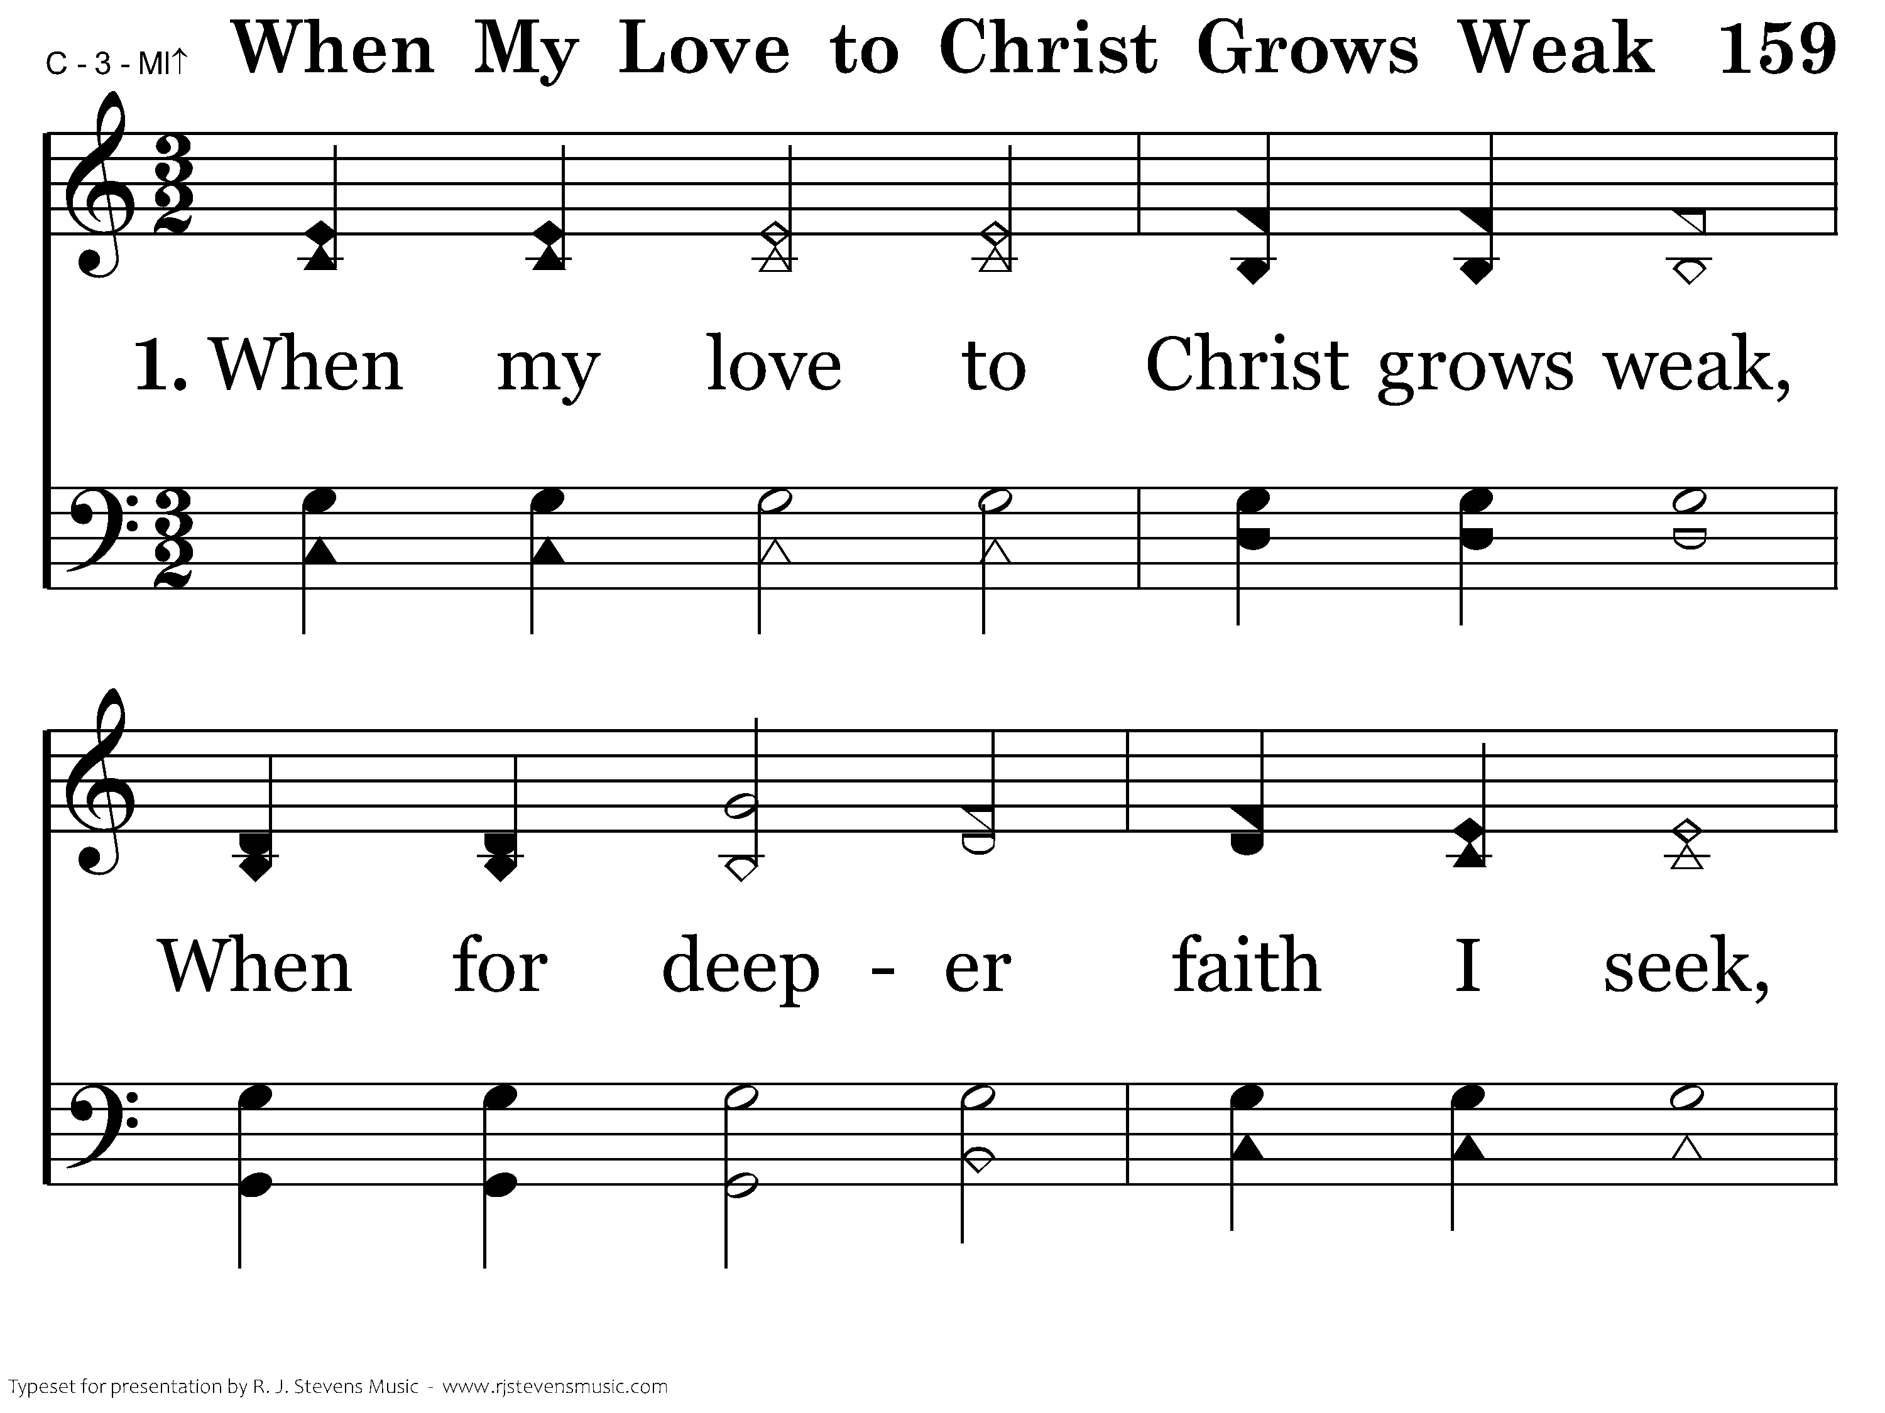
159 - When My Love To Christ Grows Weak - 1.1

Slide 59
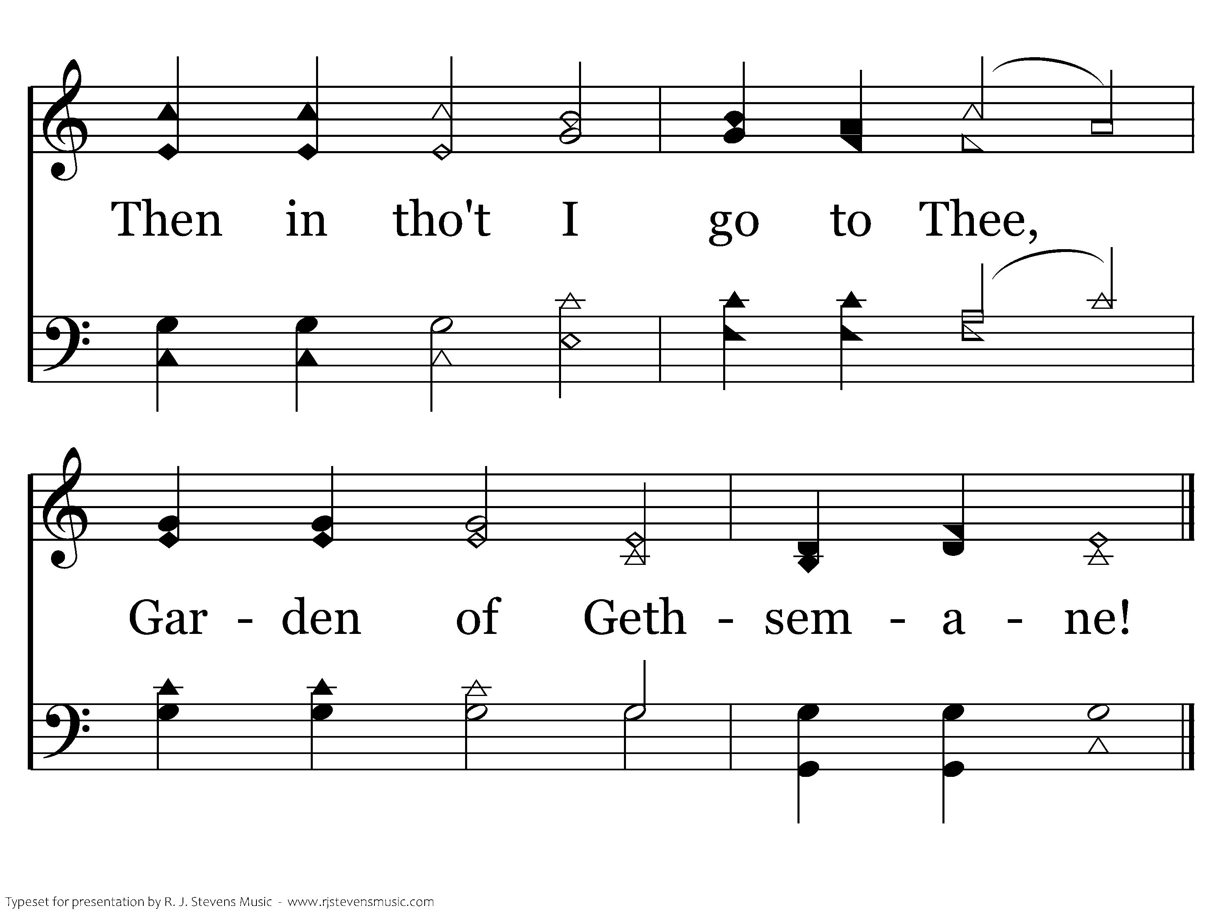
159 - When My Love To Christ Grows Weak - 1.2
End of Verse 1

Slide 60
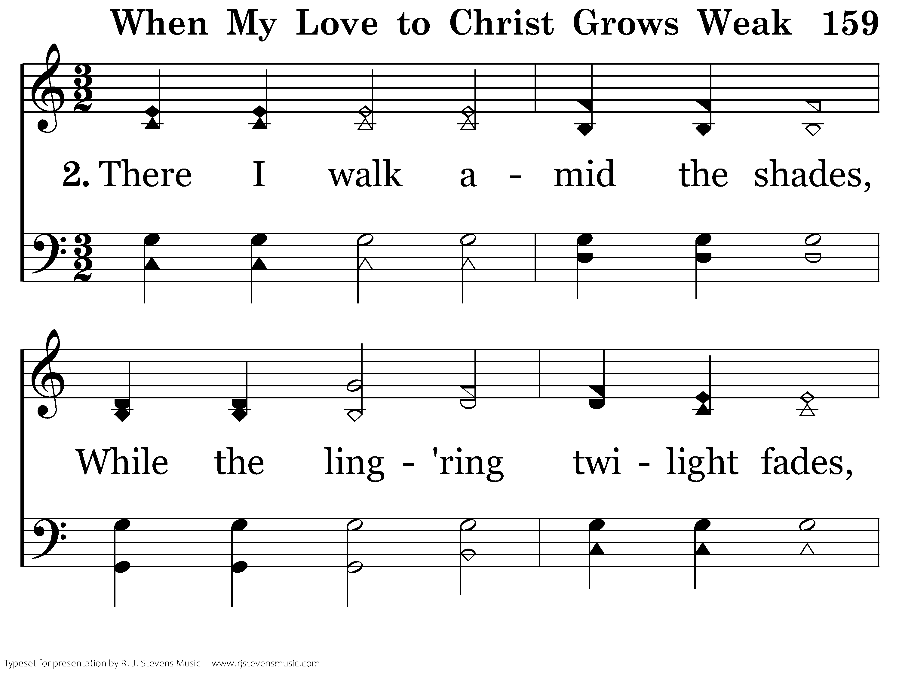
159 - When My Love To Christ Grows Weak - 2.1

Slide 61
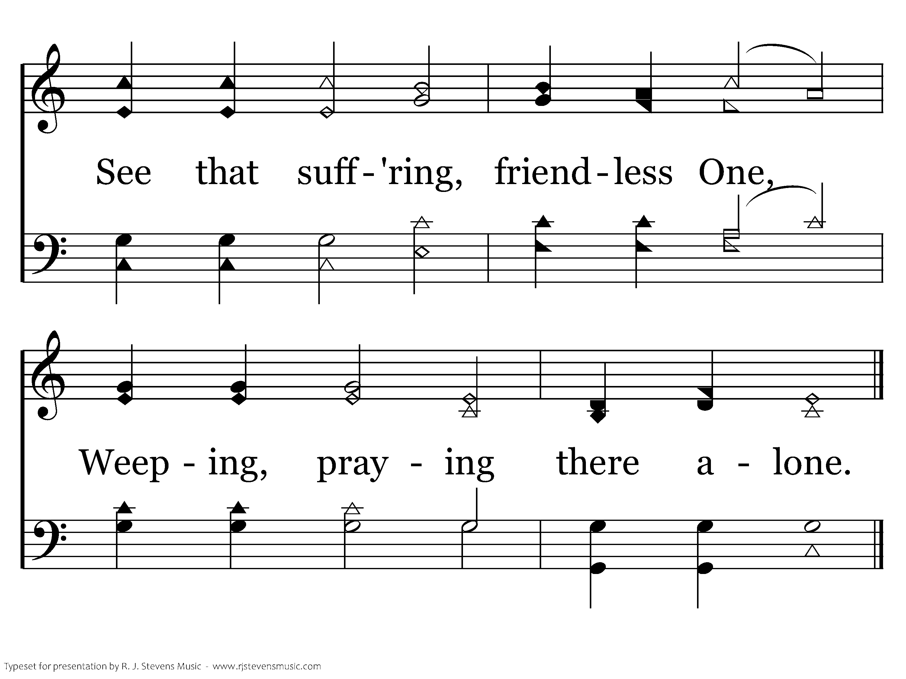
159 - When My Love To Christ Grows Weak - 2.2
End of Verse 2

Slide 62
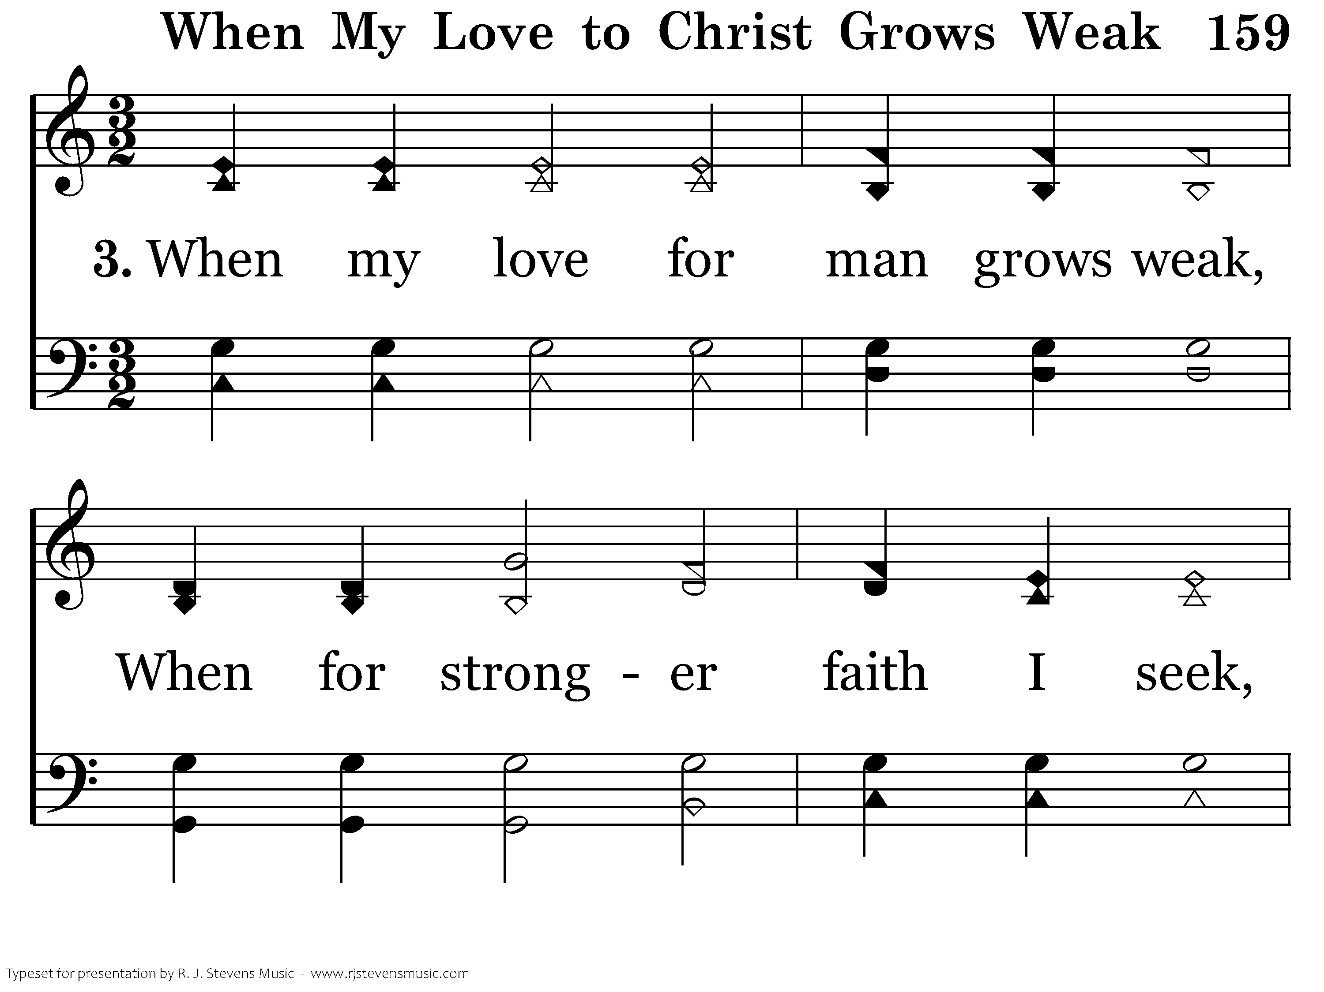
159 - When My Love To Christ Grows Weak - 3.1

Slide 63
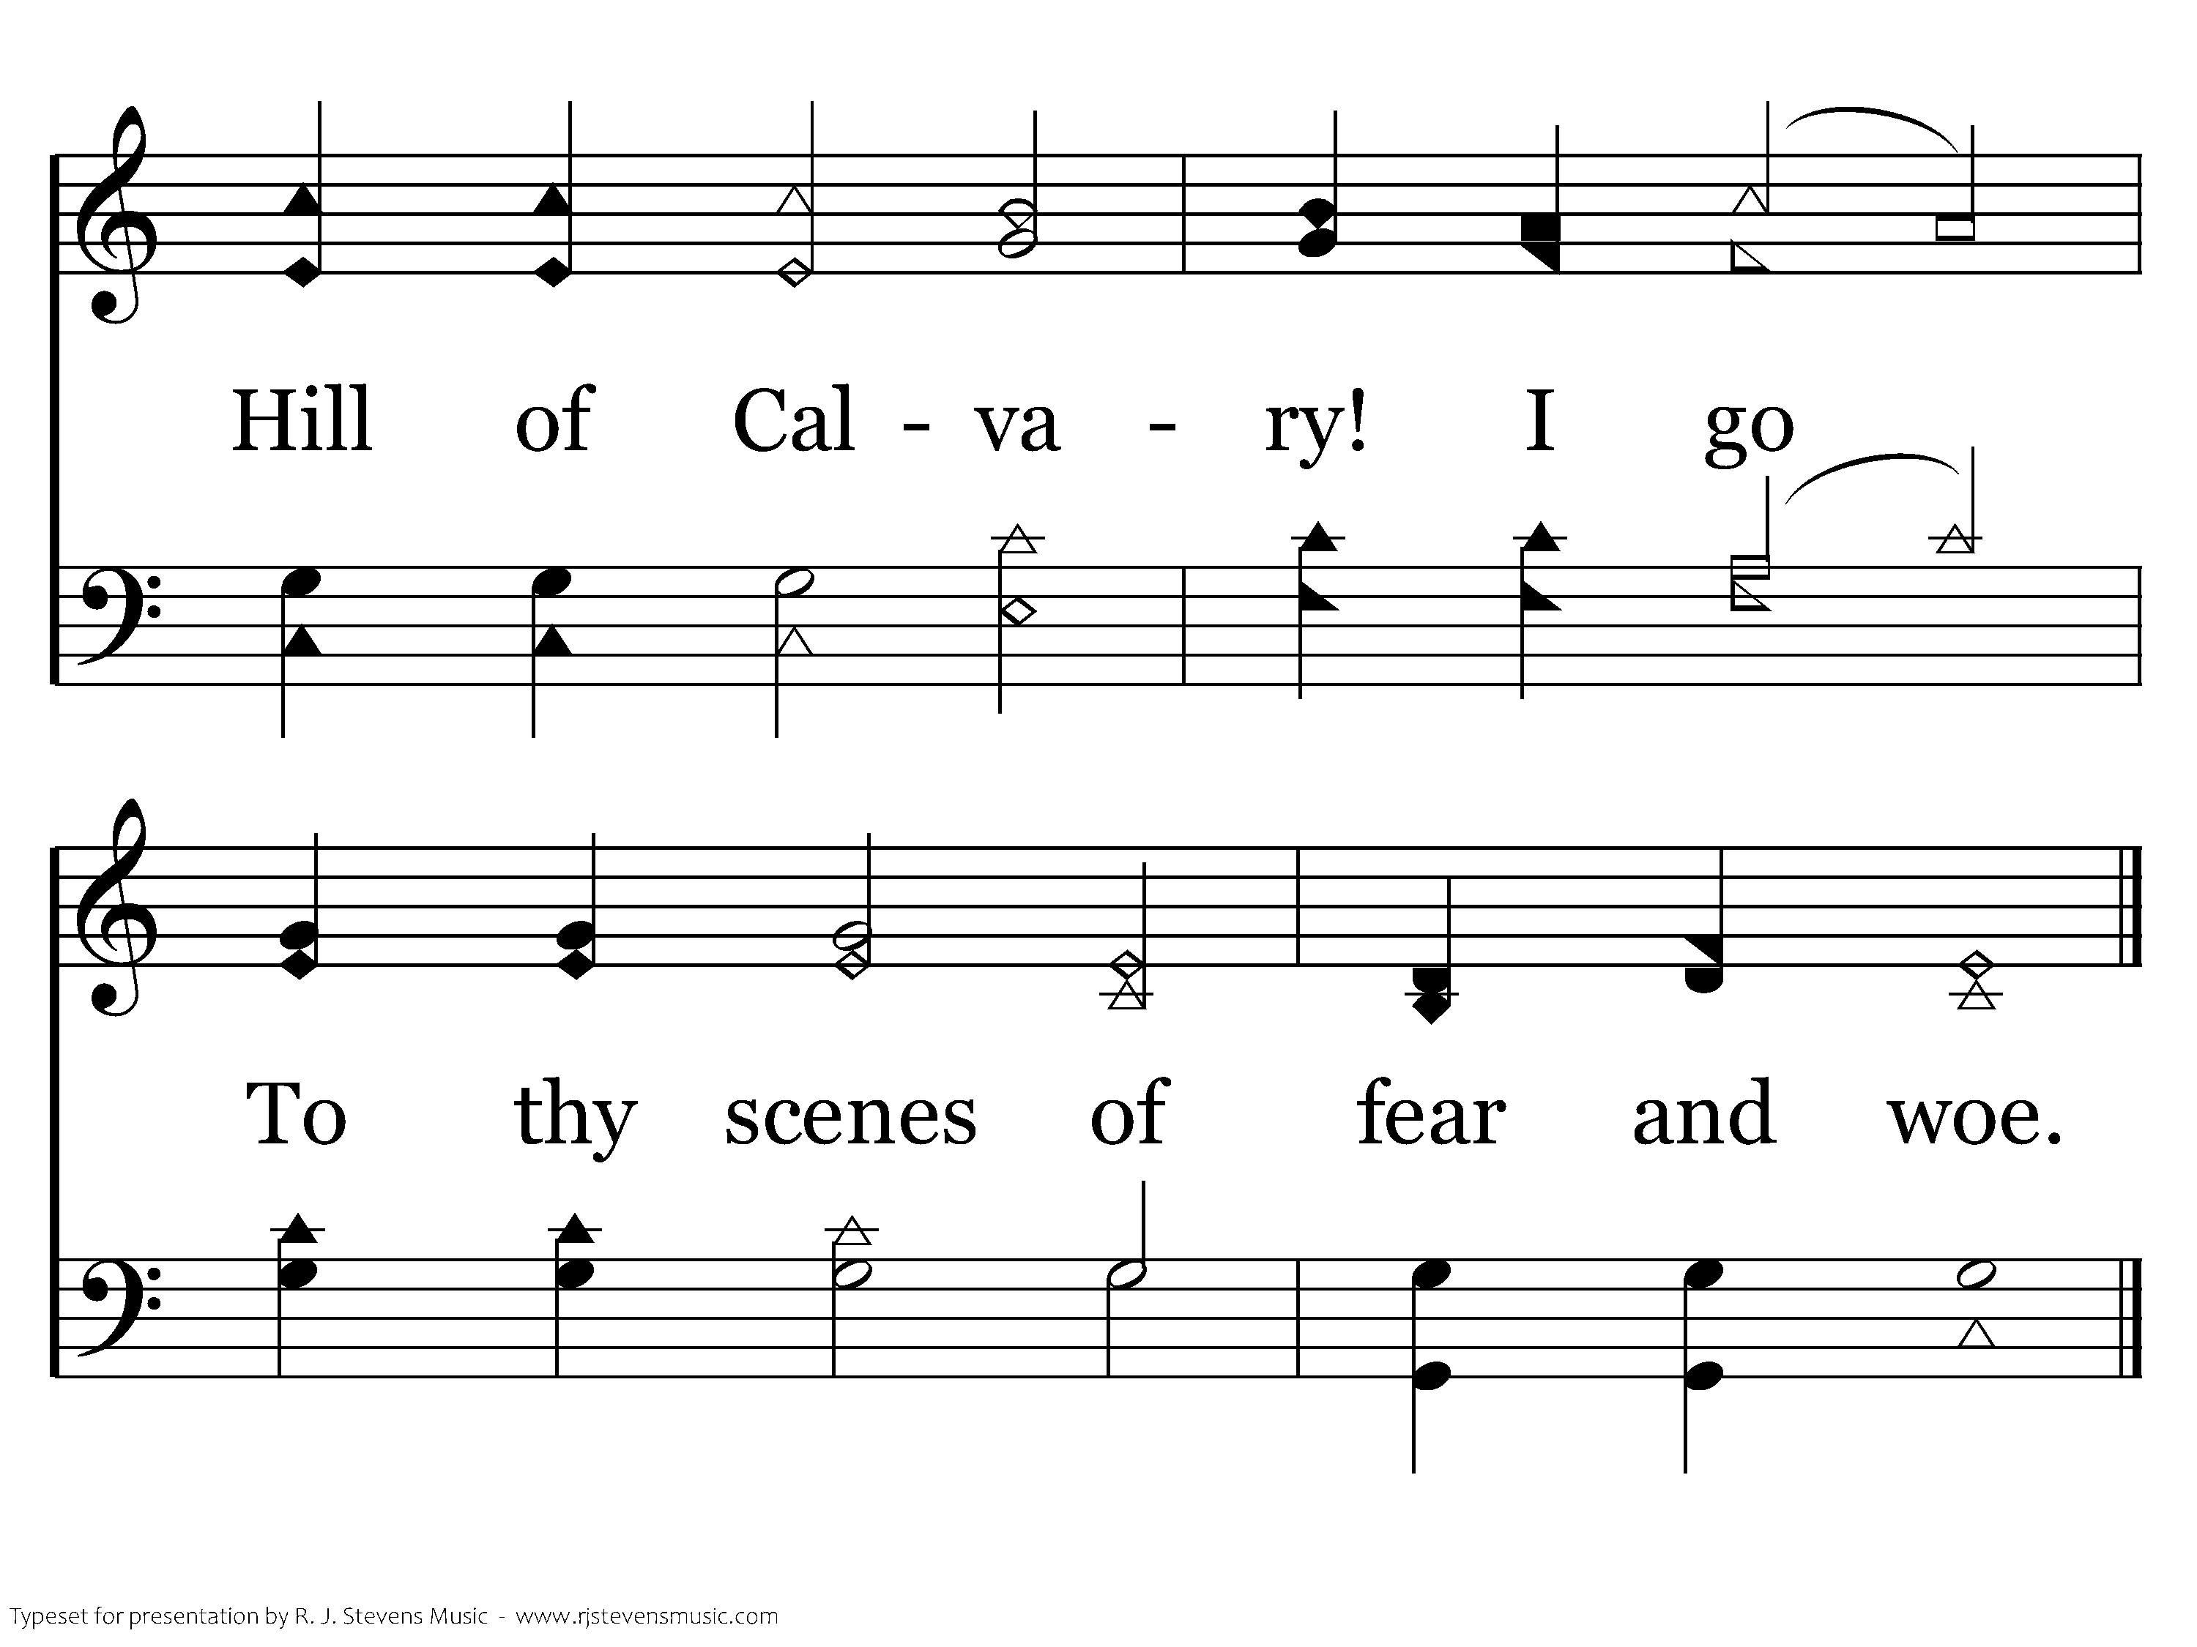
159 - When My Love To Christ Grows Weak - 3.2
End of Verse 3

Slide 64
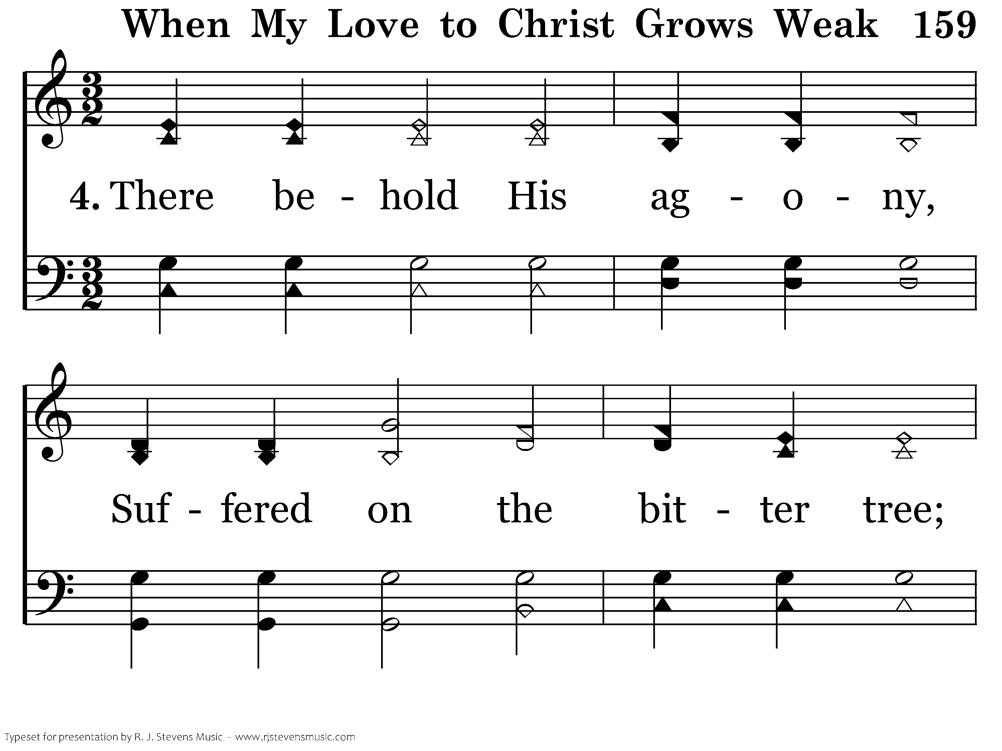
159 - When My Love To Christ Grows Weak - 4.1

Slide 65
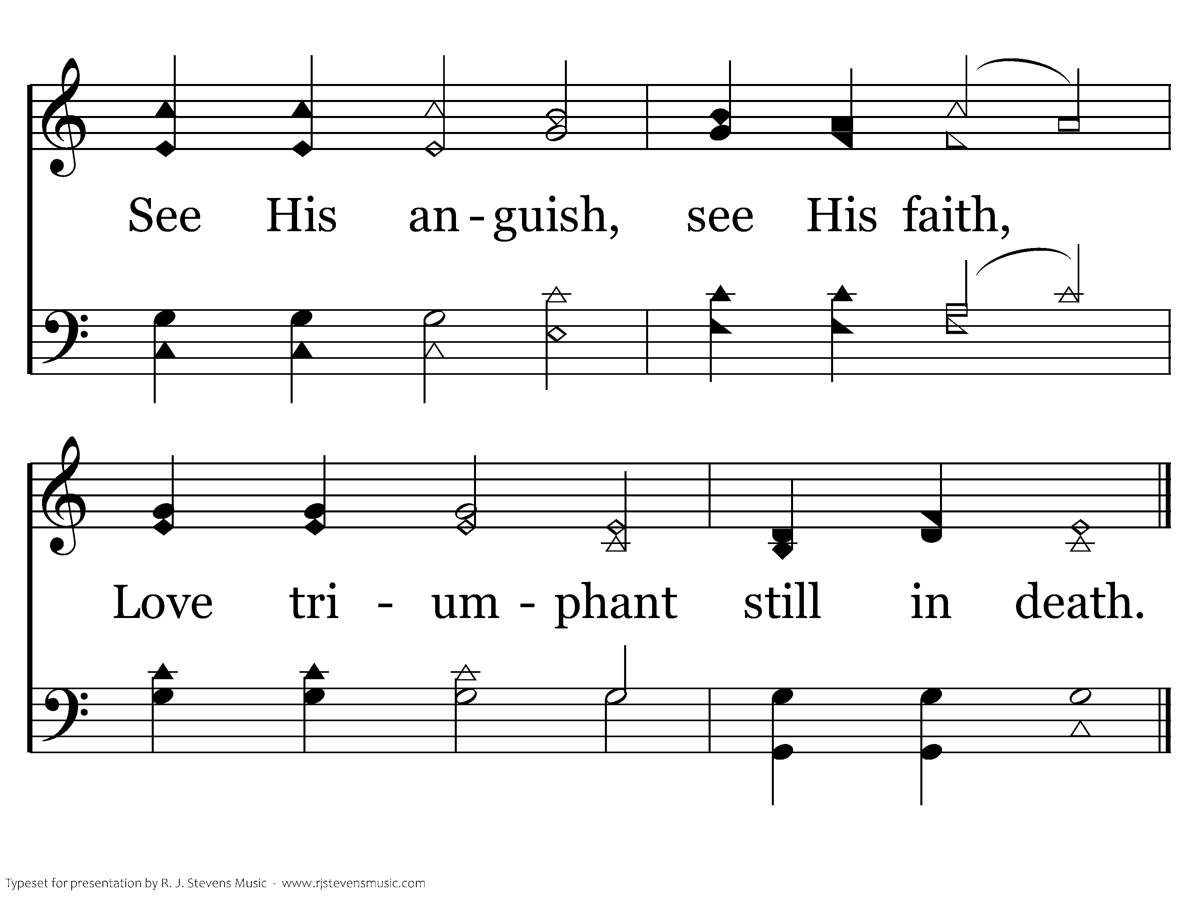
159 - When My Love To Christ Grows Weak - 4.2
End of Verse 4

Slide 66
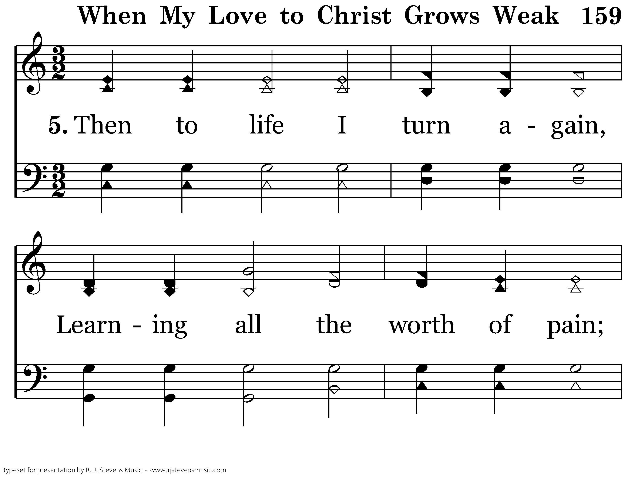
159 - When My Love To Christ Grows Weak - 5.1

Slide 67
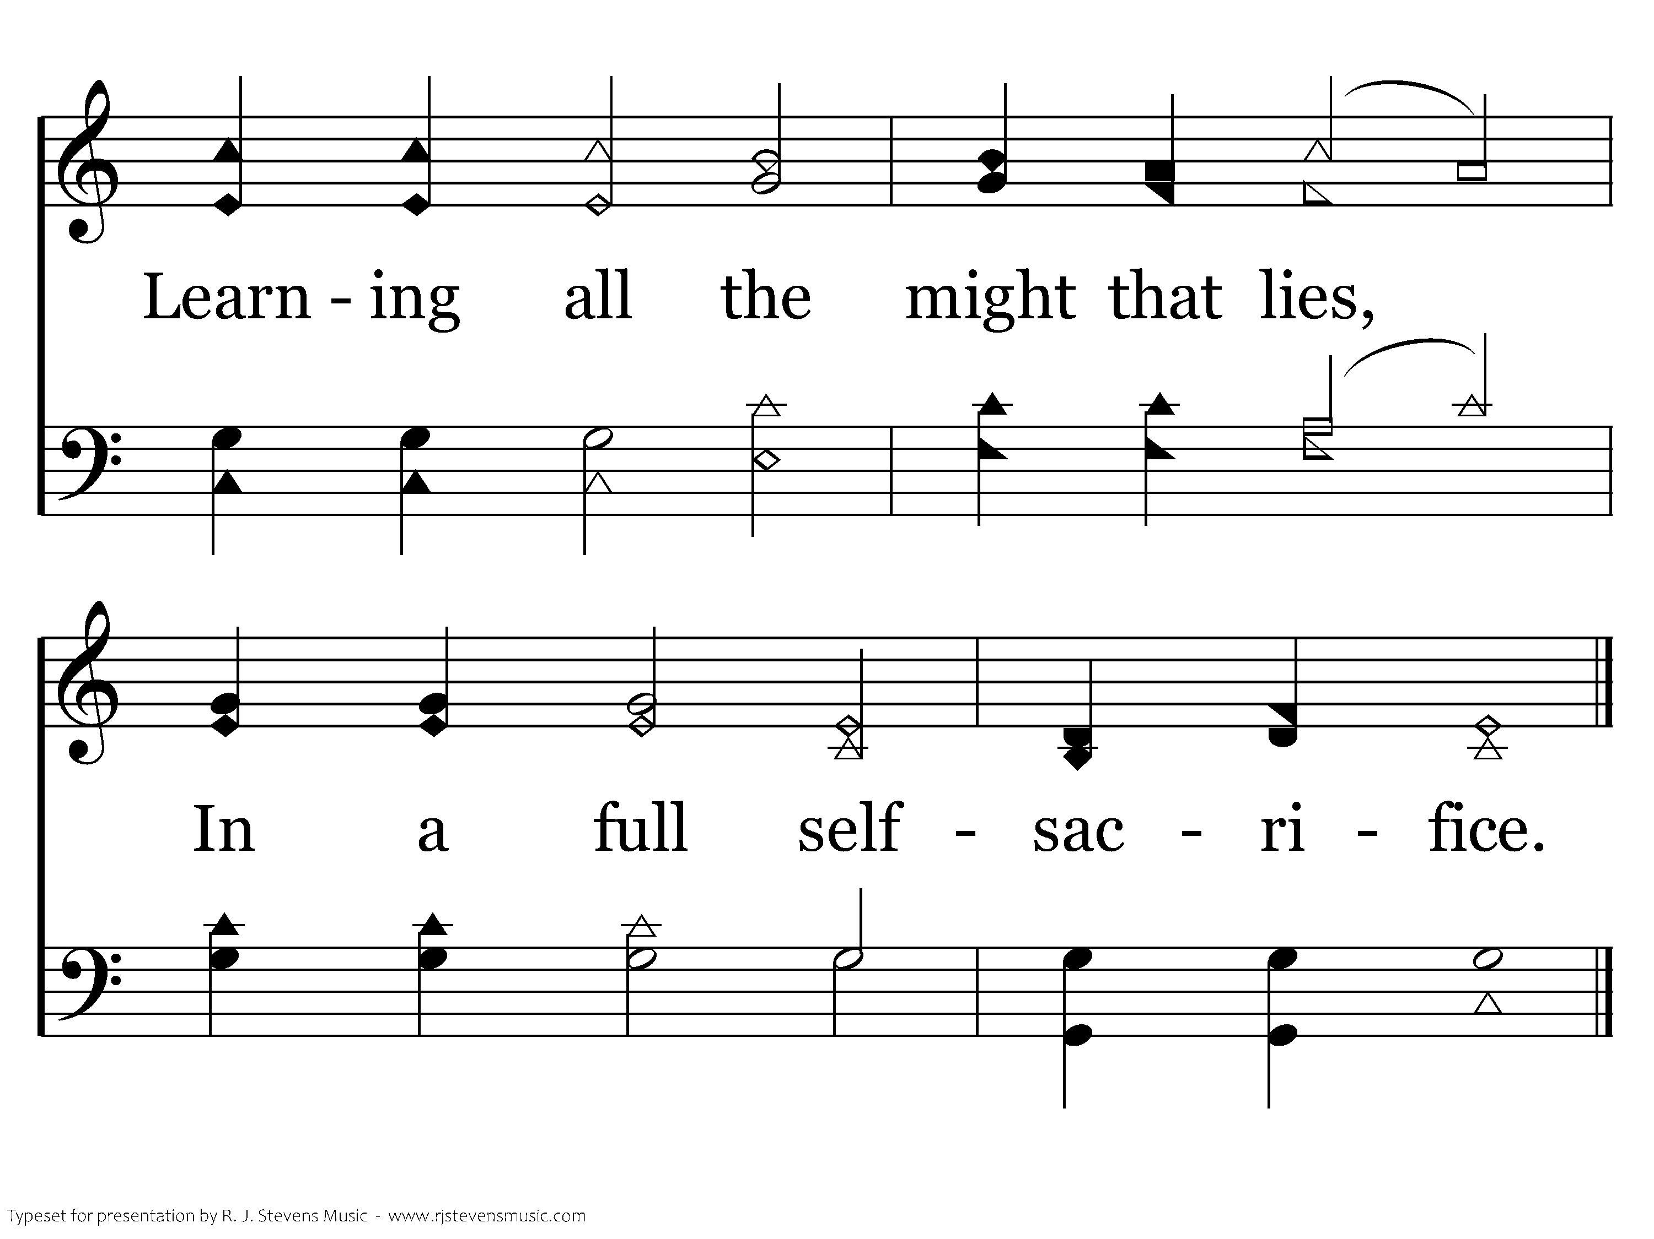
159 - When My Love To Christ Grows Weak - 5.2
End of Song

Slide 68
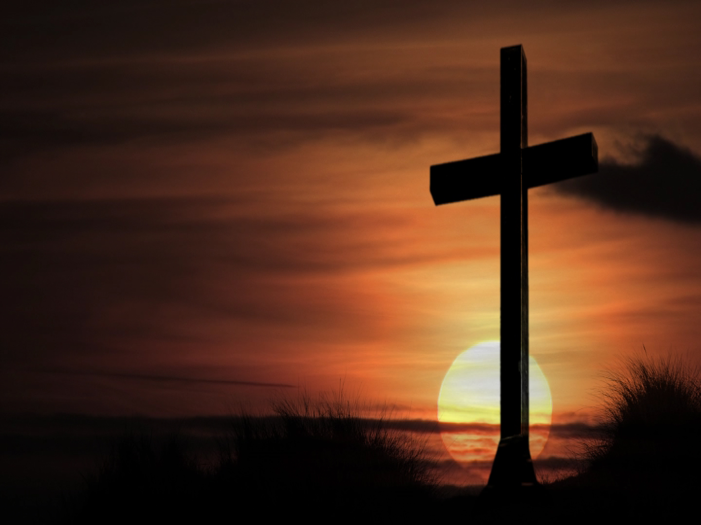
Lord’s Supper
Do this in remembrance of Me

